Slide 1


IBM for lions
•••

Slide 2
Objective and focus areas
•••

Slide 3
The evolution of the Maasai Mara ecosystem
•••

Slide 4
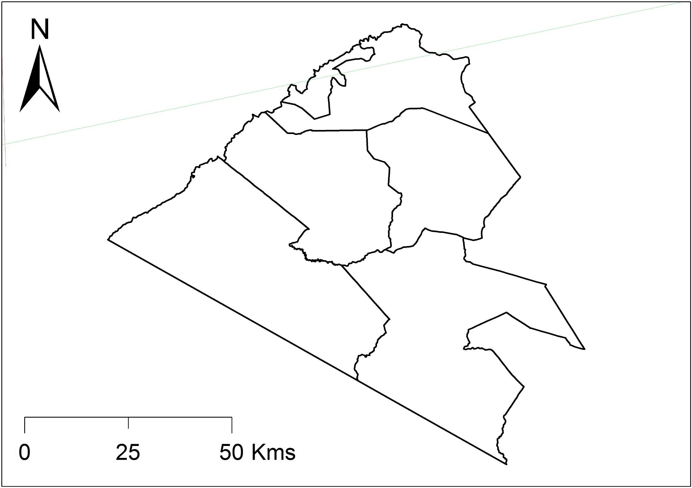
The evolution of the Maasai Mara ecosystem
•••

Slide 5
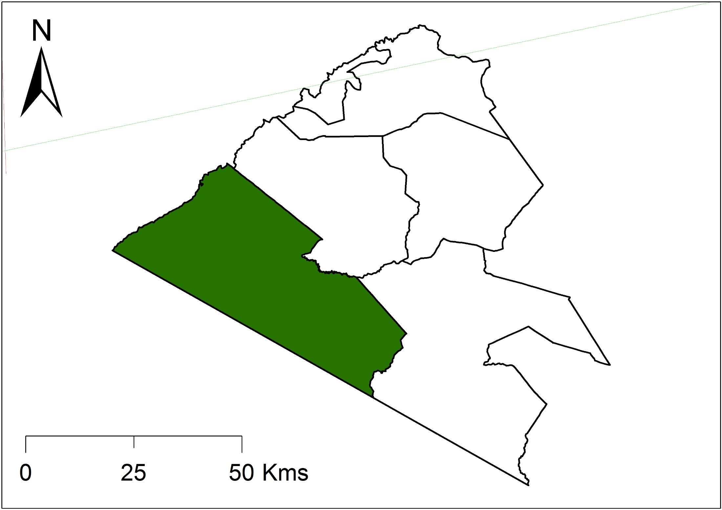
The evolution of the Maasai Mara ecosystem
•••
Maasai Mara National Reserve
1,050km2
Narok County Council

Slide 6
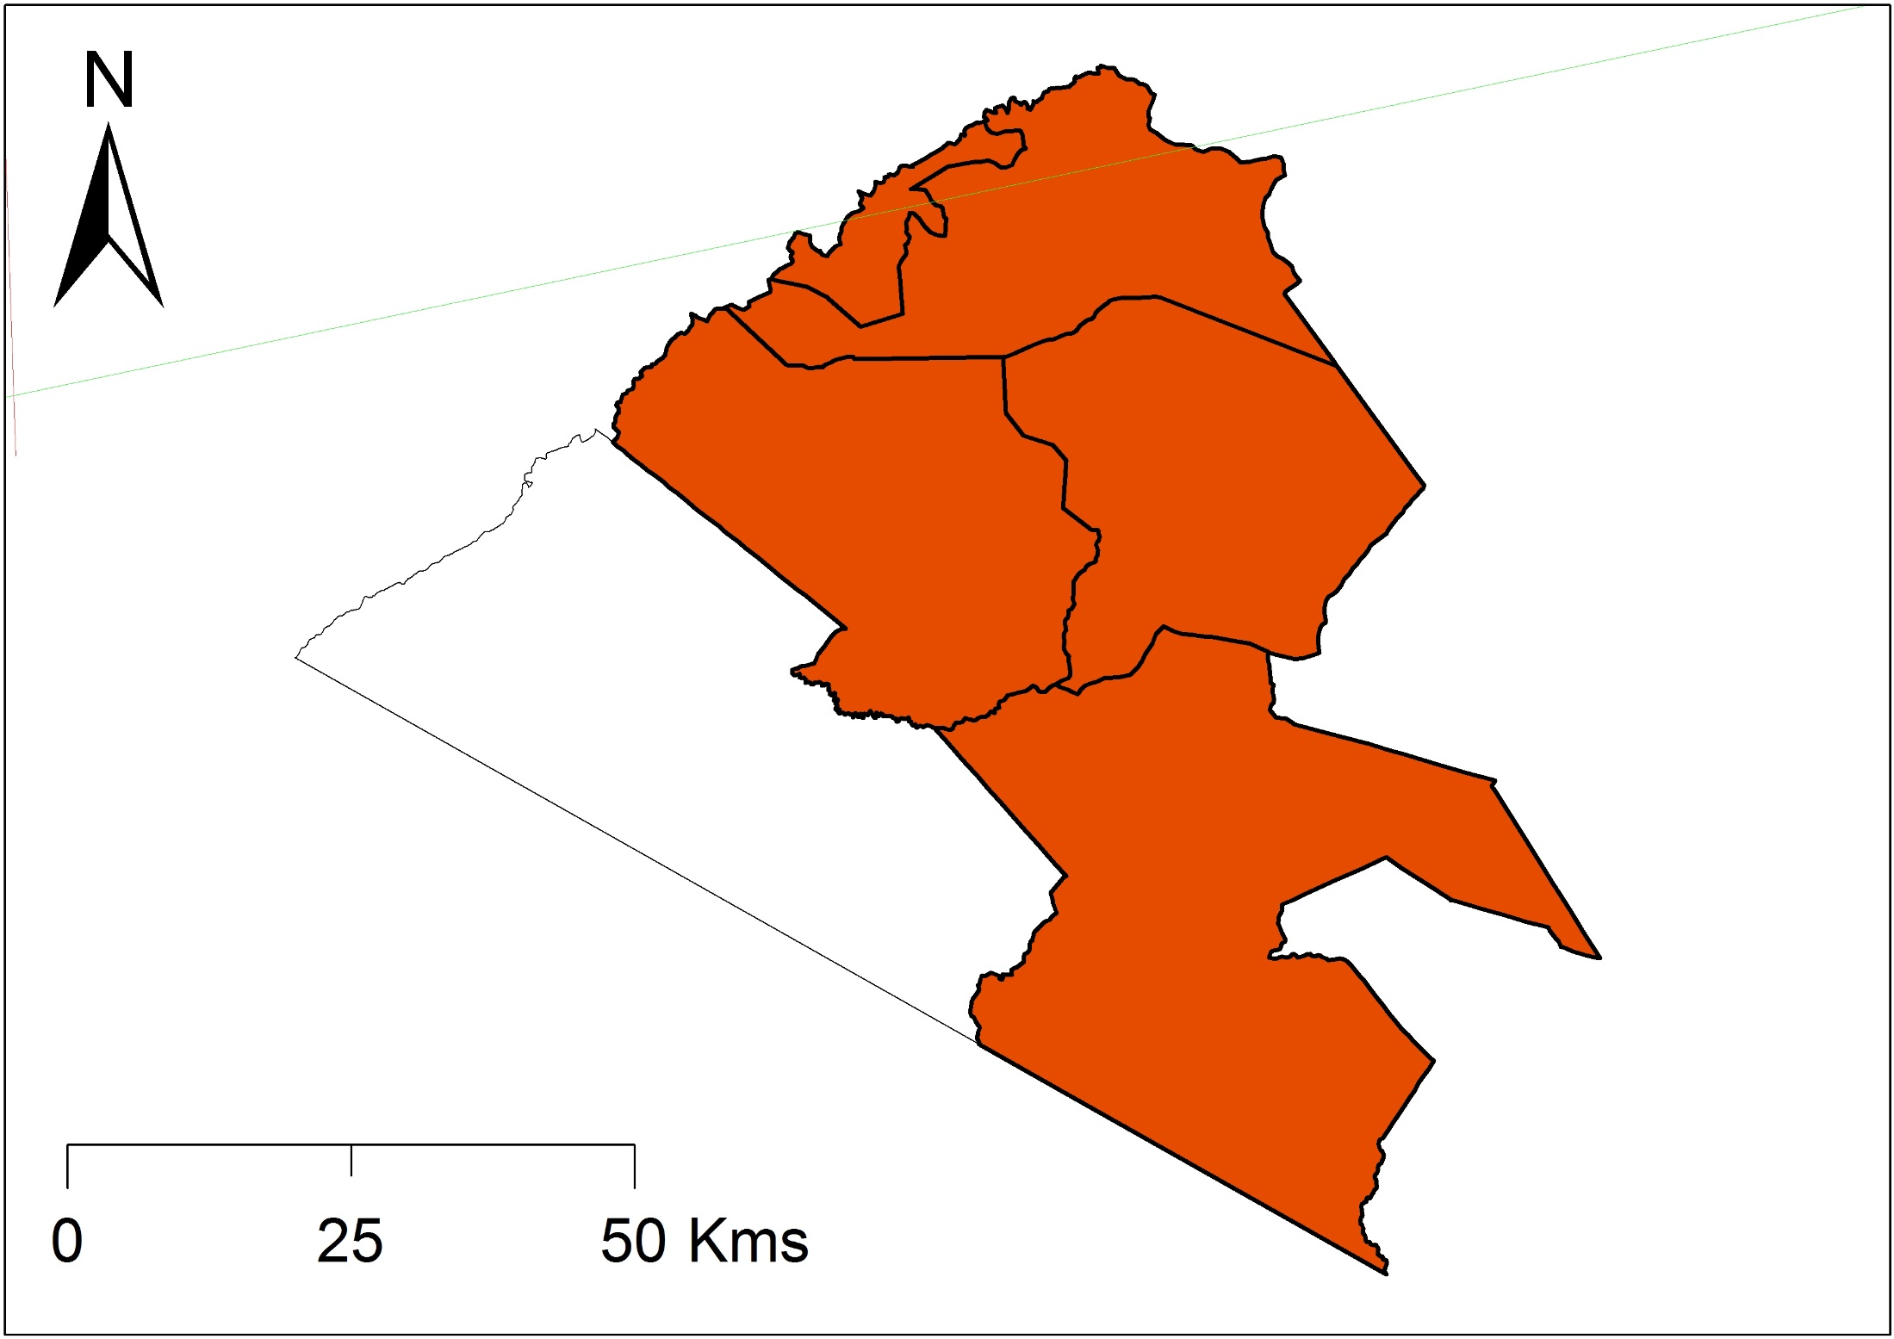
The evolution of the Maasai Mara ecosystem
•••
Group Ranches
Communally owned

Slide 7
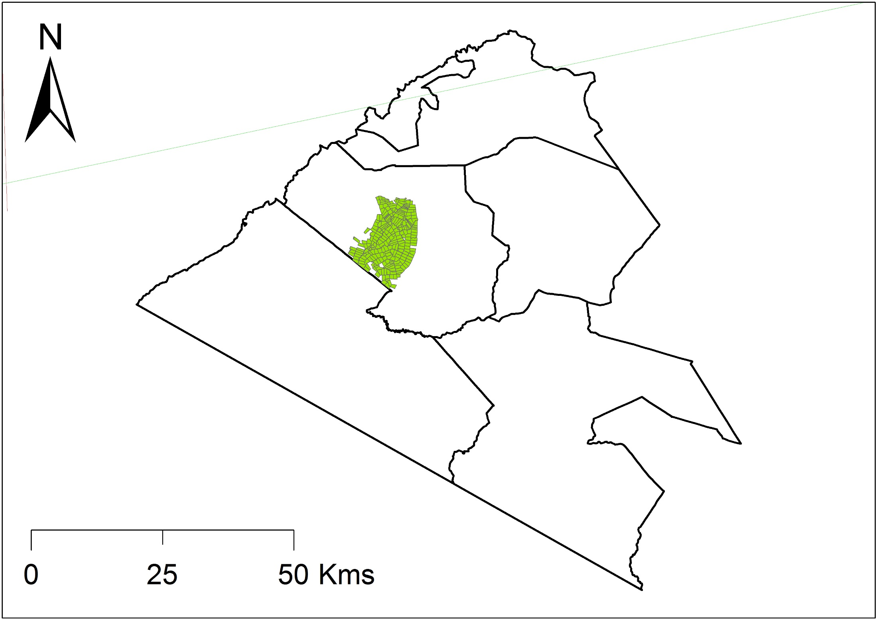
The evolution of the Maasai Mara ecosystem
•••
Subdivision ~ 10 yrs ago

Slide 8
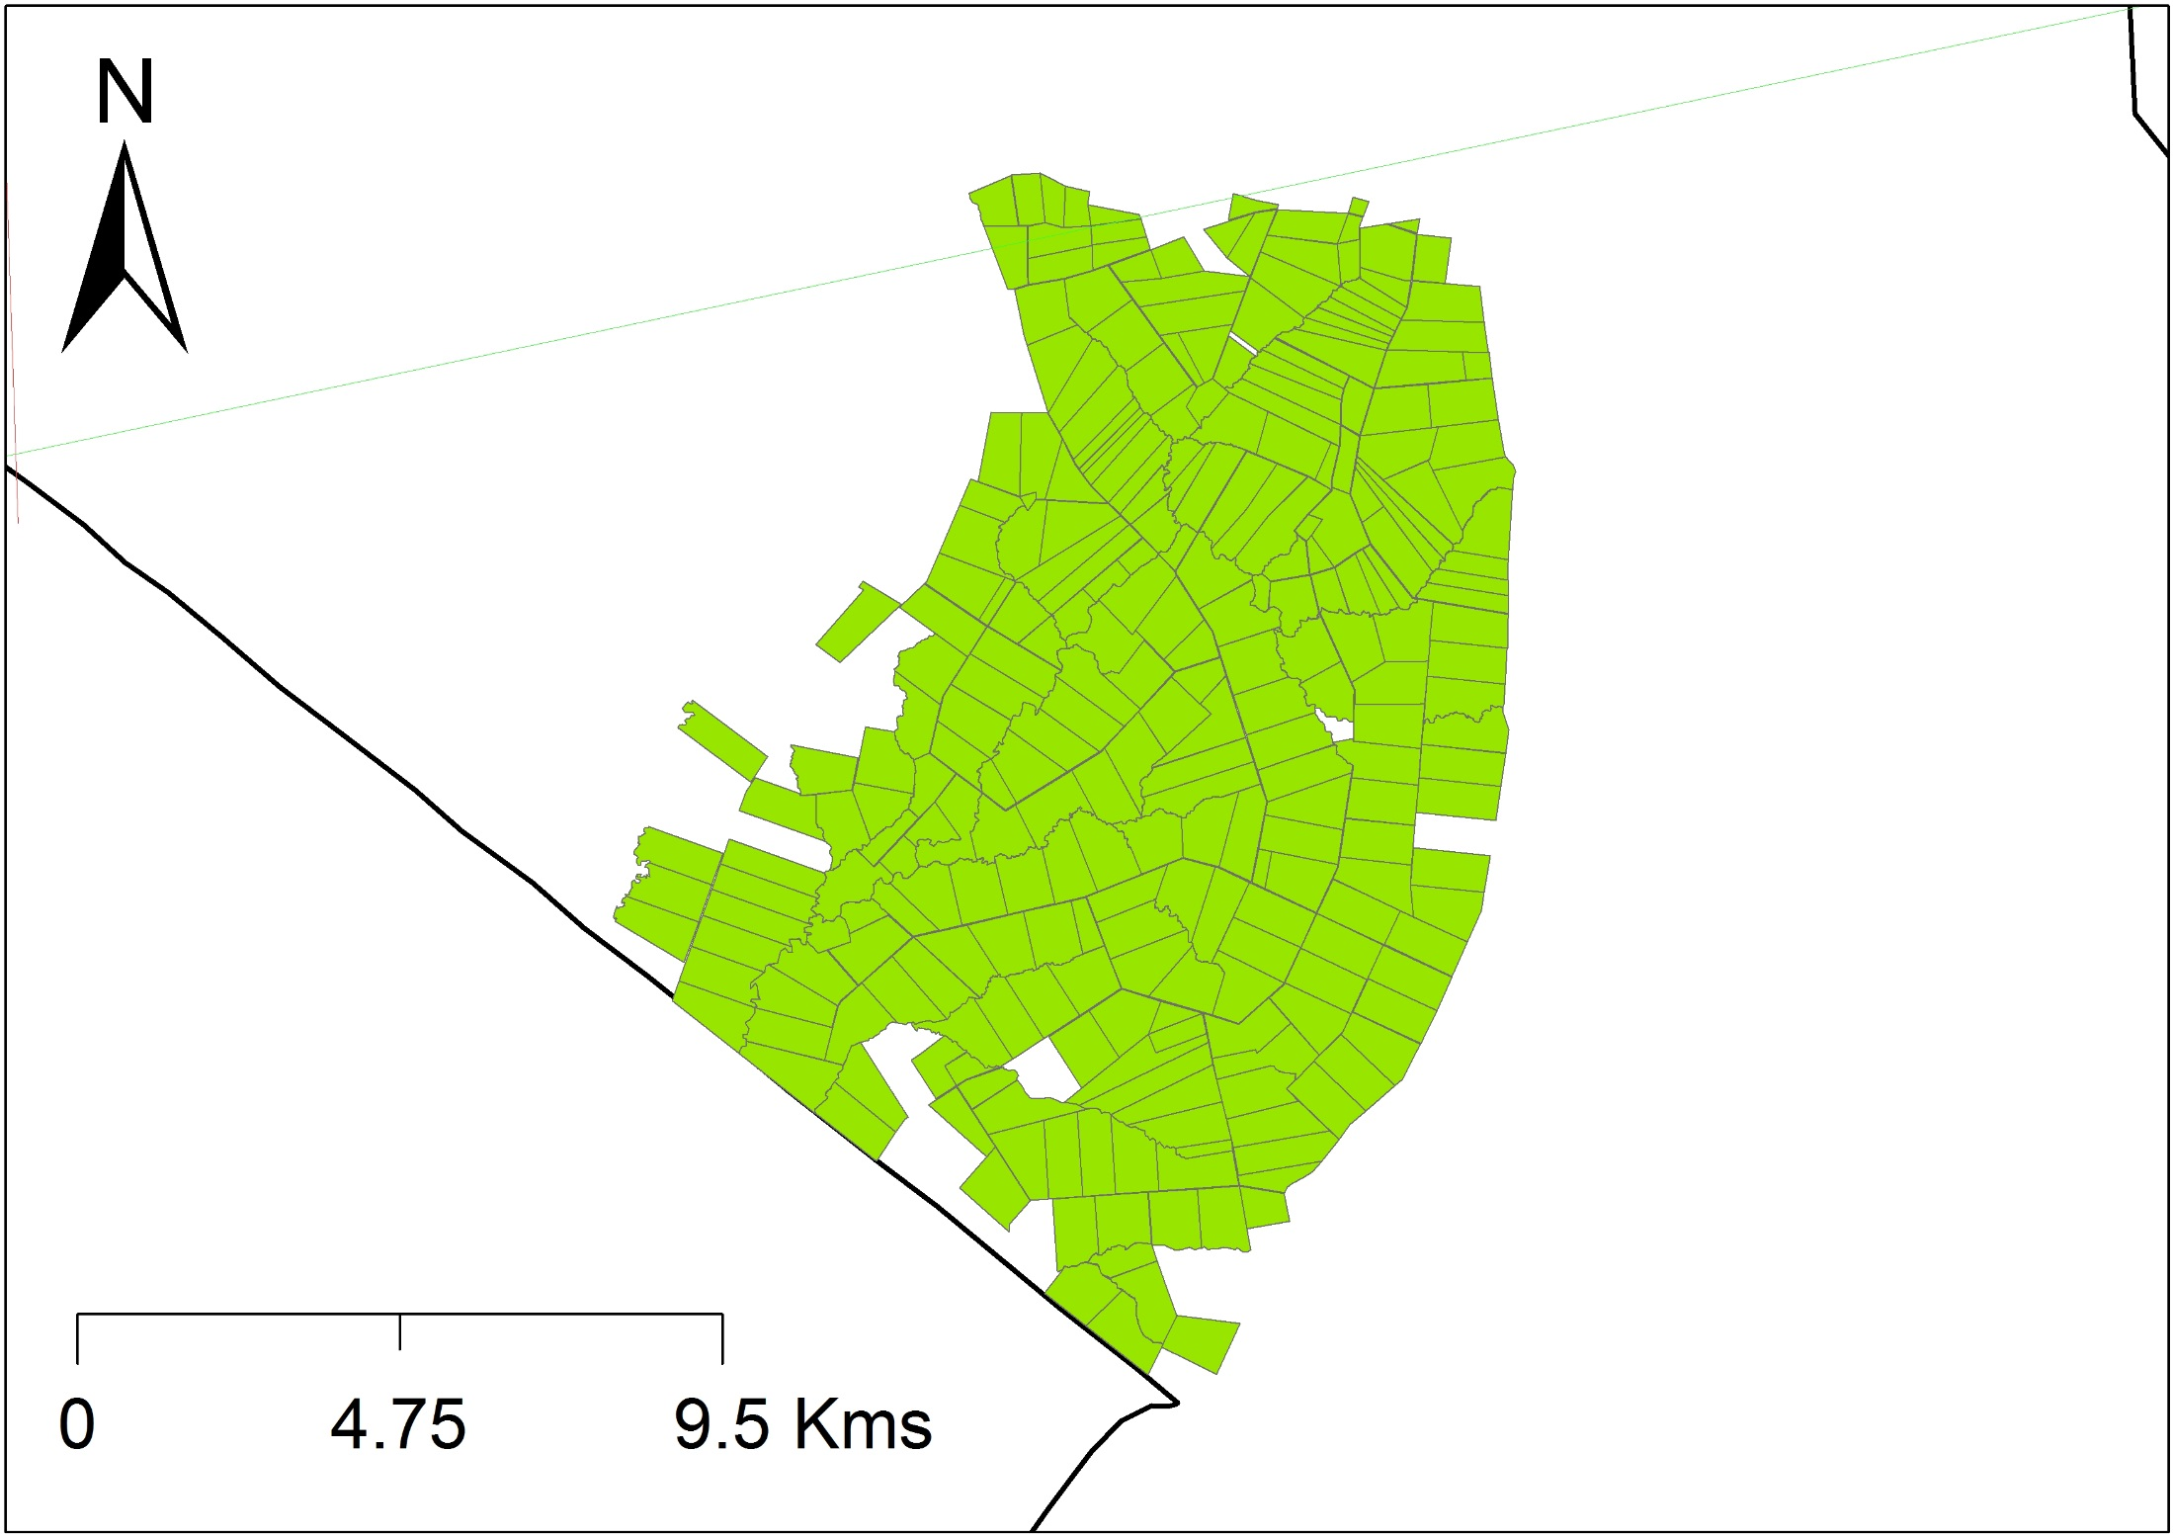
The evolution of the Maasai Mara ecosystem
•••
Subdivision ~ 10 yrs ago
1000s Title deeds issued – monthly rents to the community

Slide 9
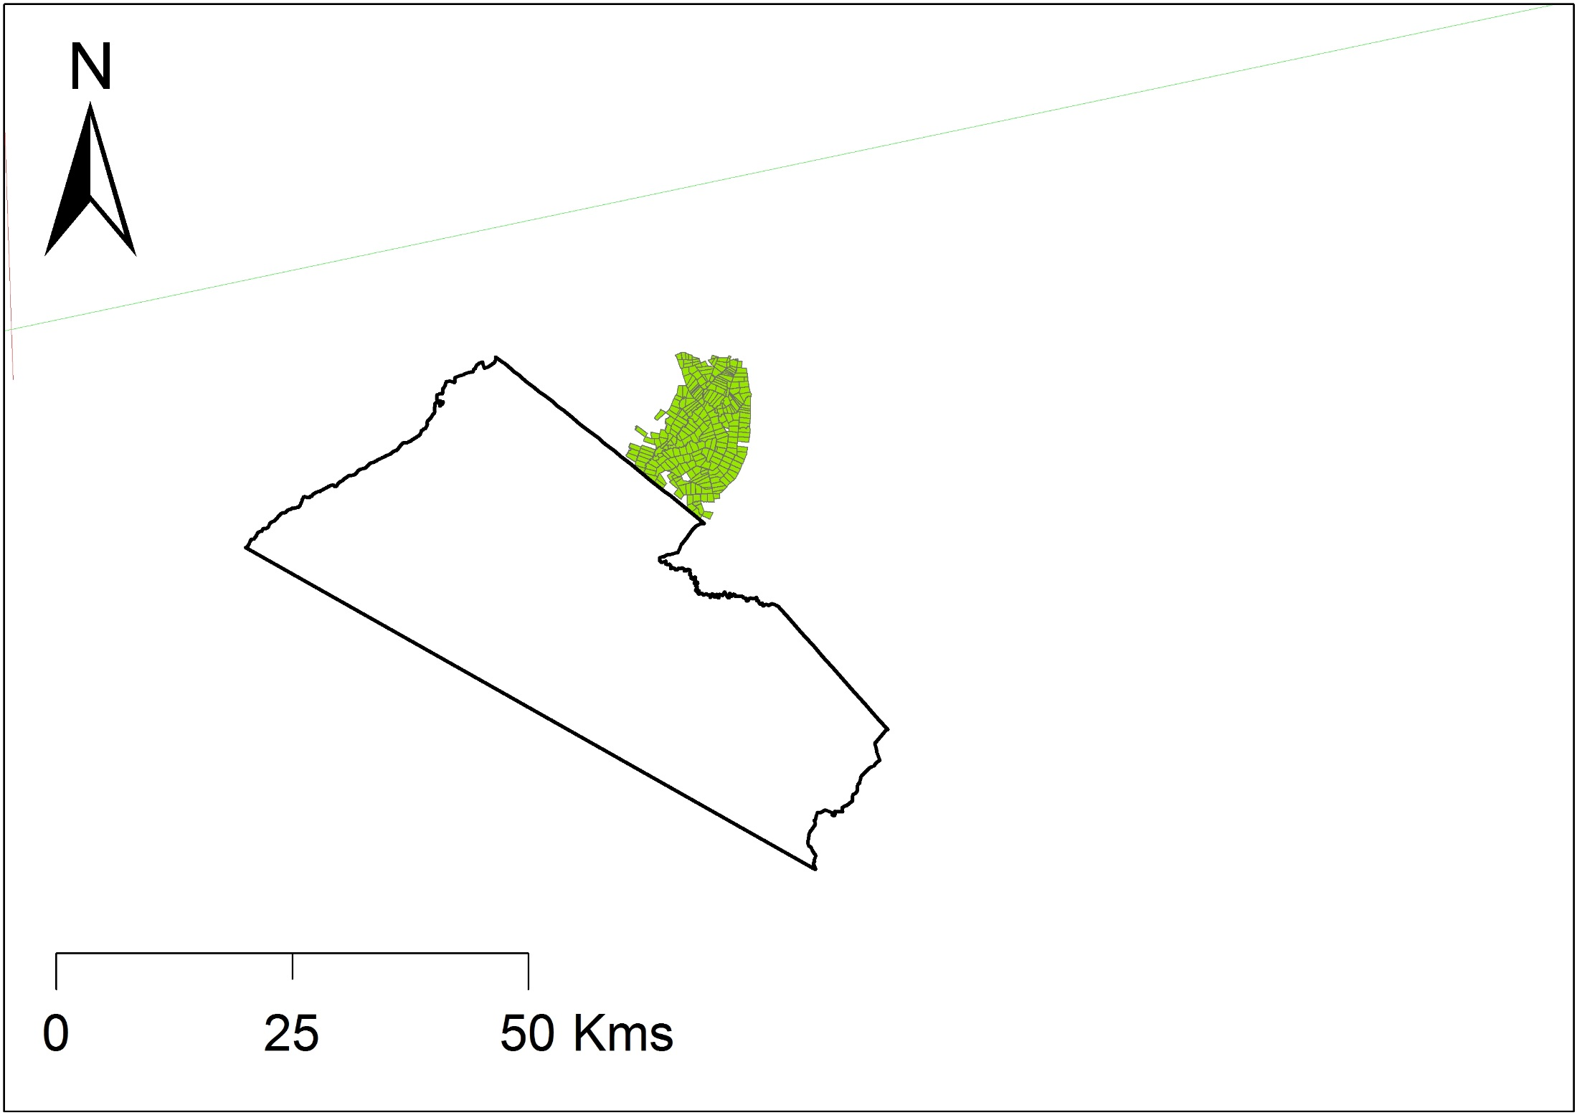
The evolution of the Maasai Mara ecosystem
•••
Subdivision led to the creation of conservancies

Slide 10


The evolution of the Maasai Mara ecosystem
•••
Subdivision
People moved out and the land was transformed into conservancies

Slide 11
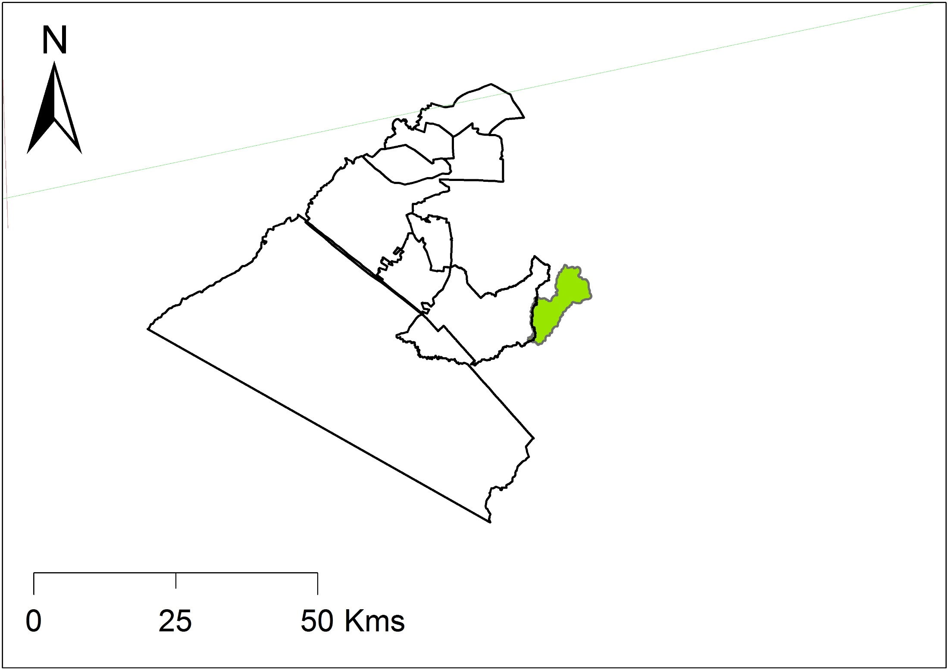
The evolution of the Maasai Mara ecosystem
•••
Ol Kinyei
63km2
2005

Slide 12
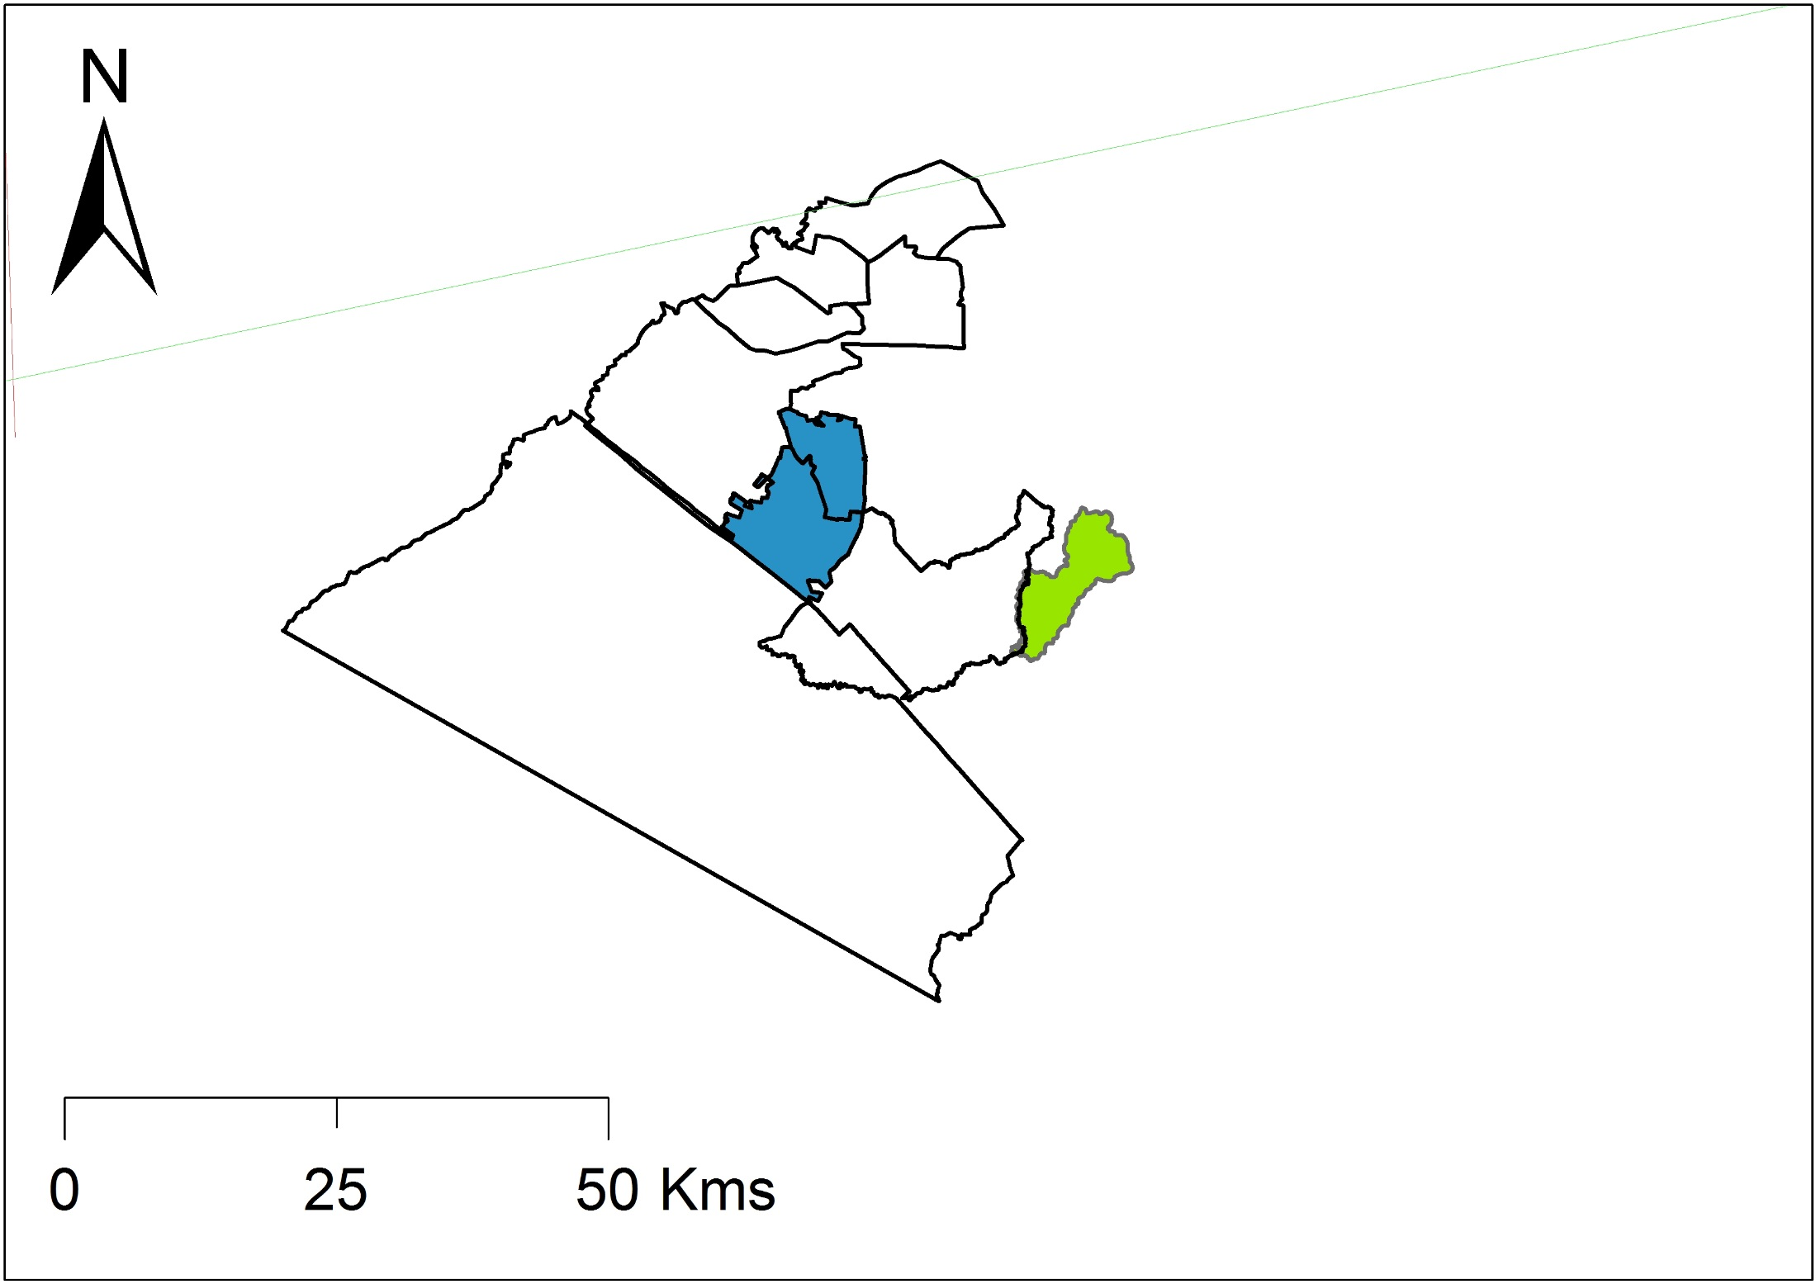
The evolution of the Maasai Mara ecosystem
•••
OMC
138 km2
2005

Slide 13
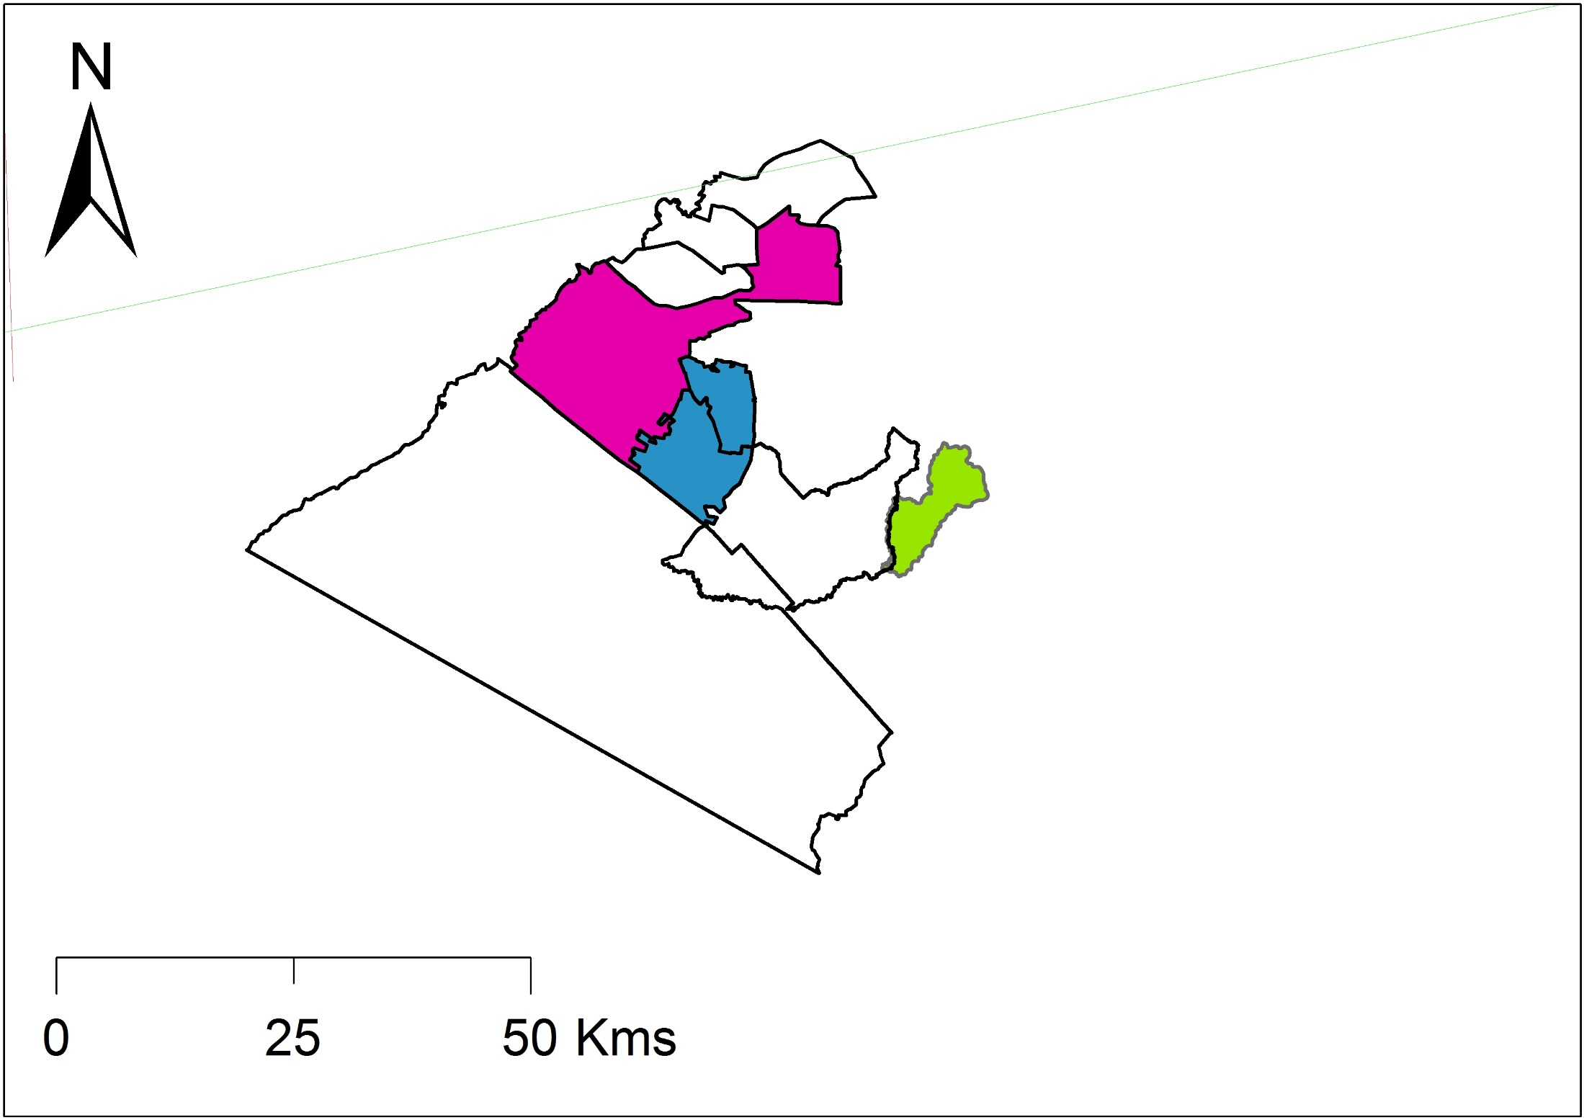
The evolution of the Maasai Mara ecosystem
•••
MMC
345 km2
2009

Slide 14
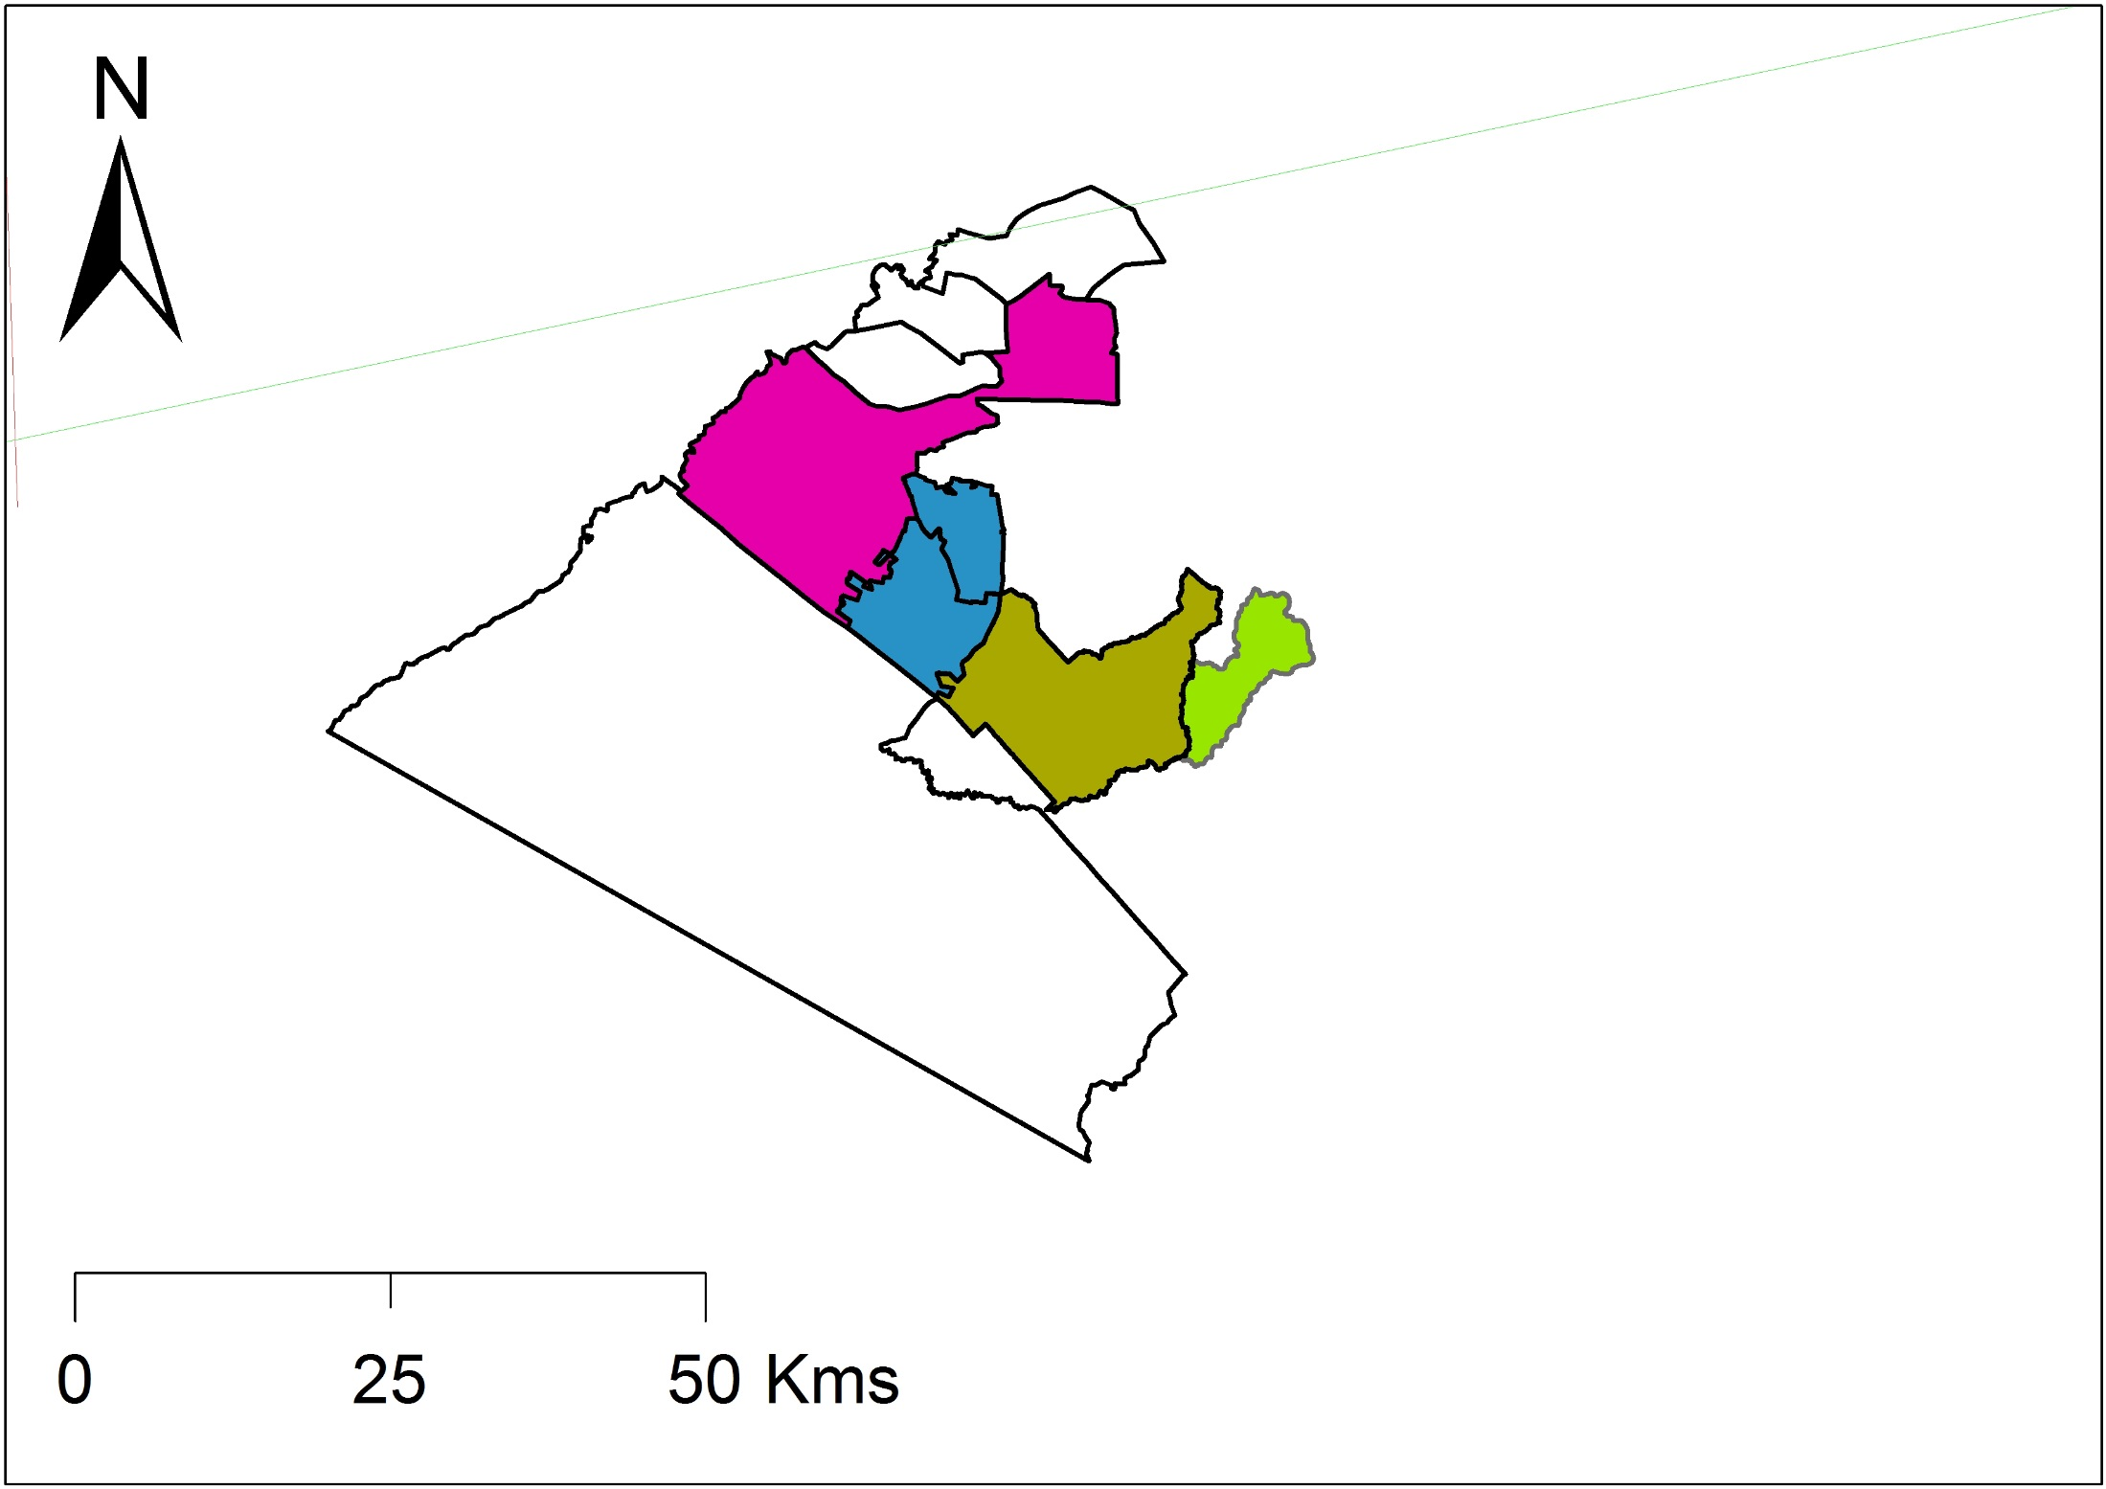
The evolution of the Maasai Mara ecosystem
•••
Naboisho
210 km2
2010

Slide 15
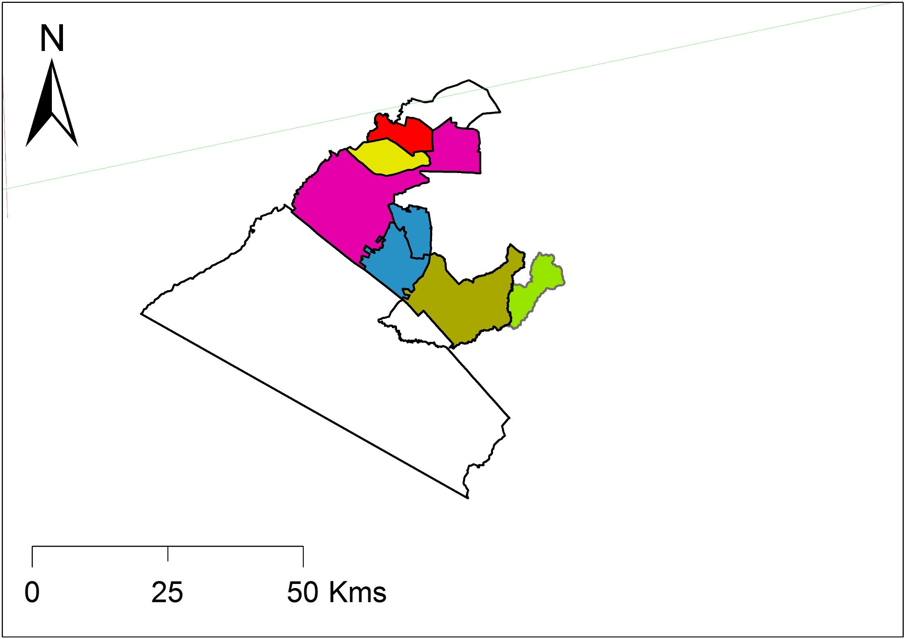
The evolution of the Maasai Mara ecosystem
•••
Lemek and OI Chorro
116 km2
2009 & 1992

Slide 16
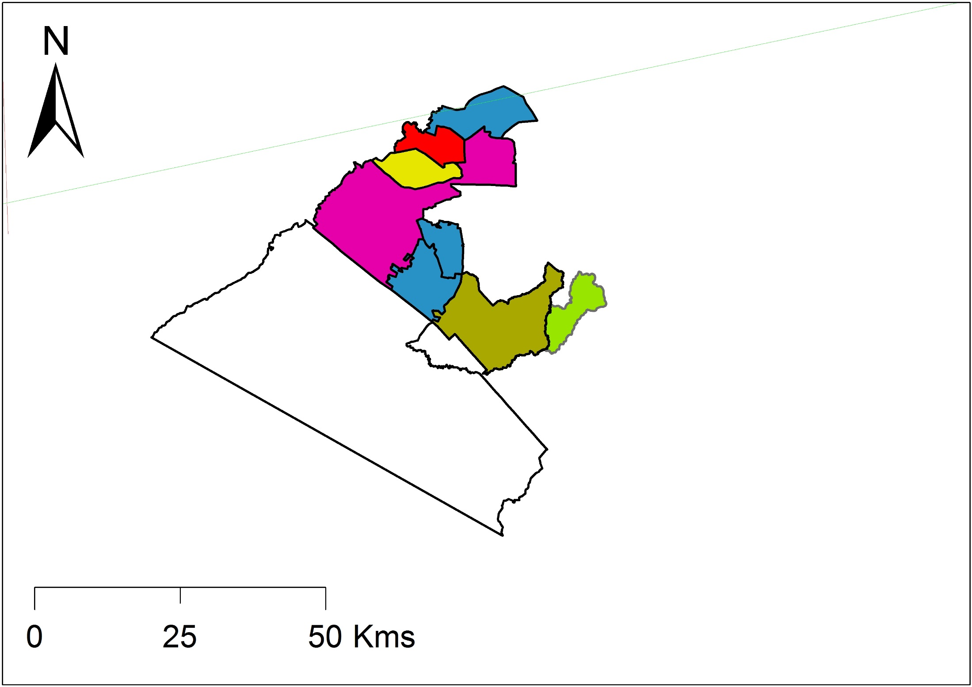
The evolution of the Maasai Mara ecosystem
•••
Enonkishu
2011

Slide 17

The evolution of the Maasai Mara ecosystem
•••
Olarro
2009

Slide 18

The evolution of the Maasai Mara ecosystem
•••
Oloisukut
2011

Slide 19
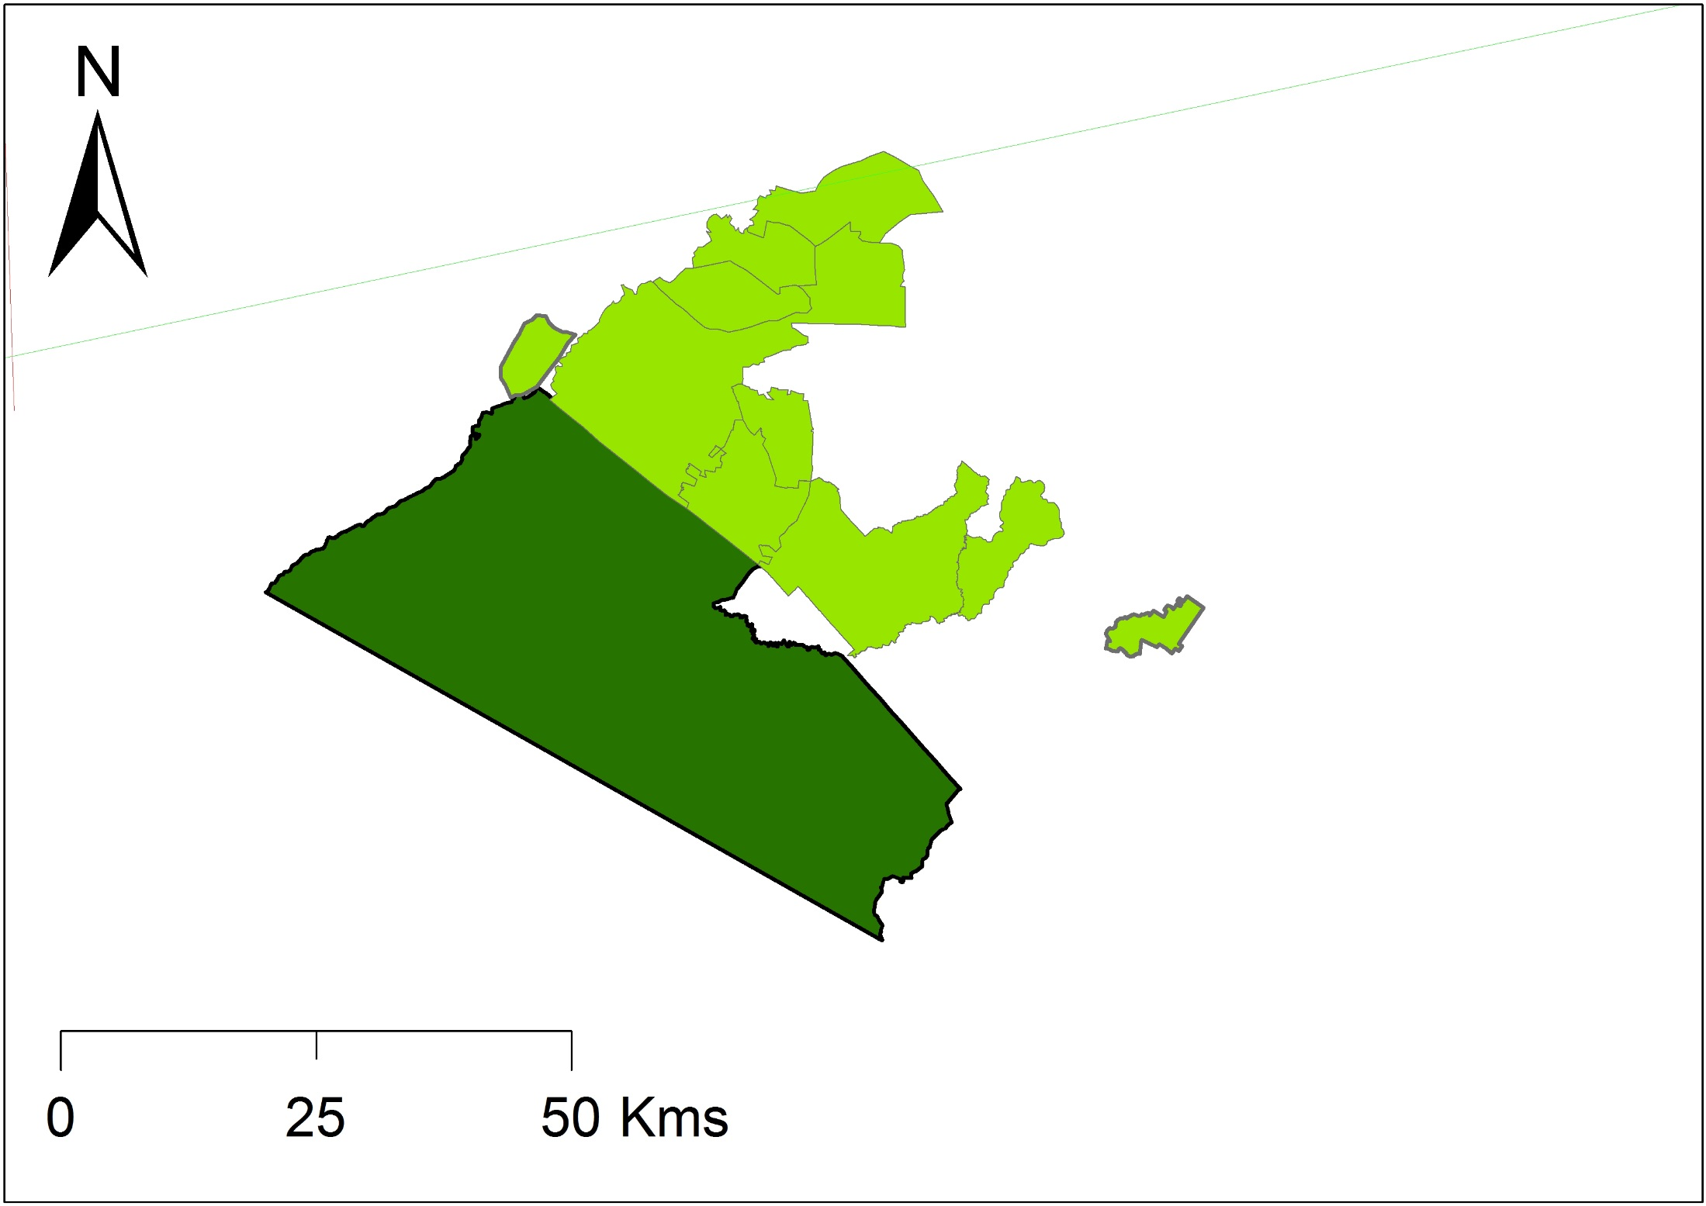
The evolution of the Maasai Mara ecosystem
Highly controlled livestock
•••
Livestock grazing year round
All current protected areas
Compensation
Each conservancy has different management policies, allowing for a perfect natural experiment
Annual burning,
No livestock
No Livestock
Livestock grazing year round

Slide 20
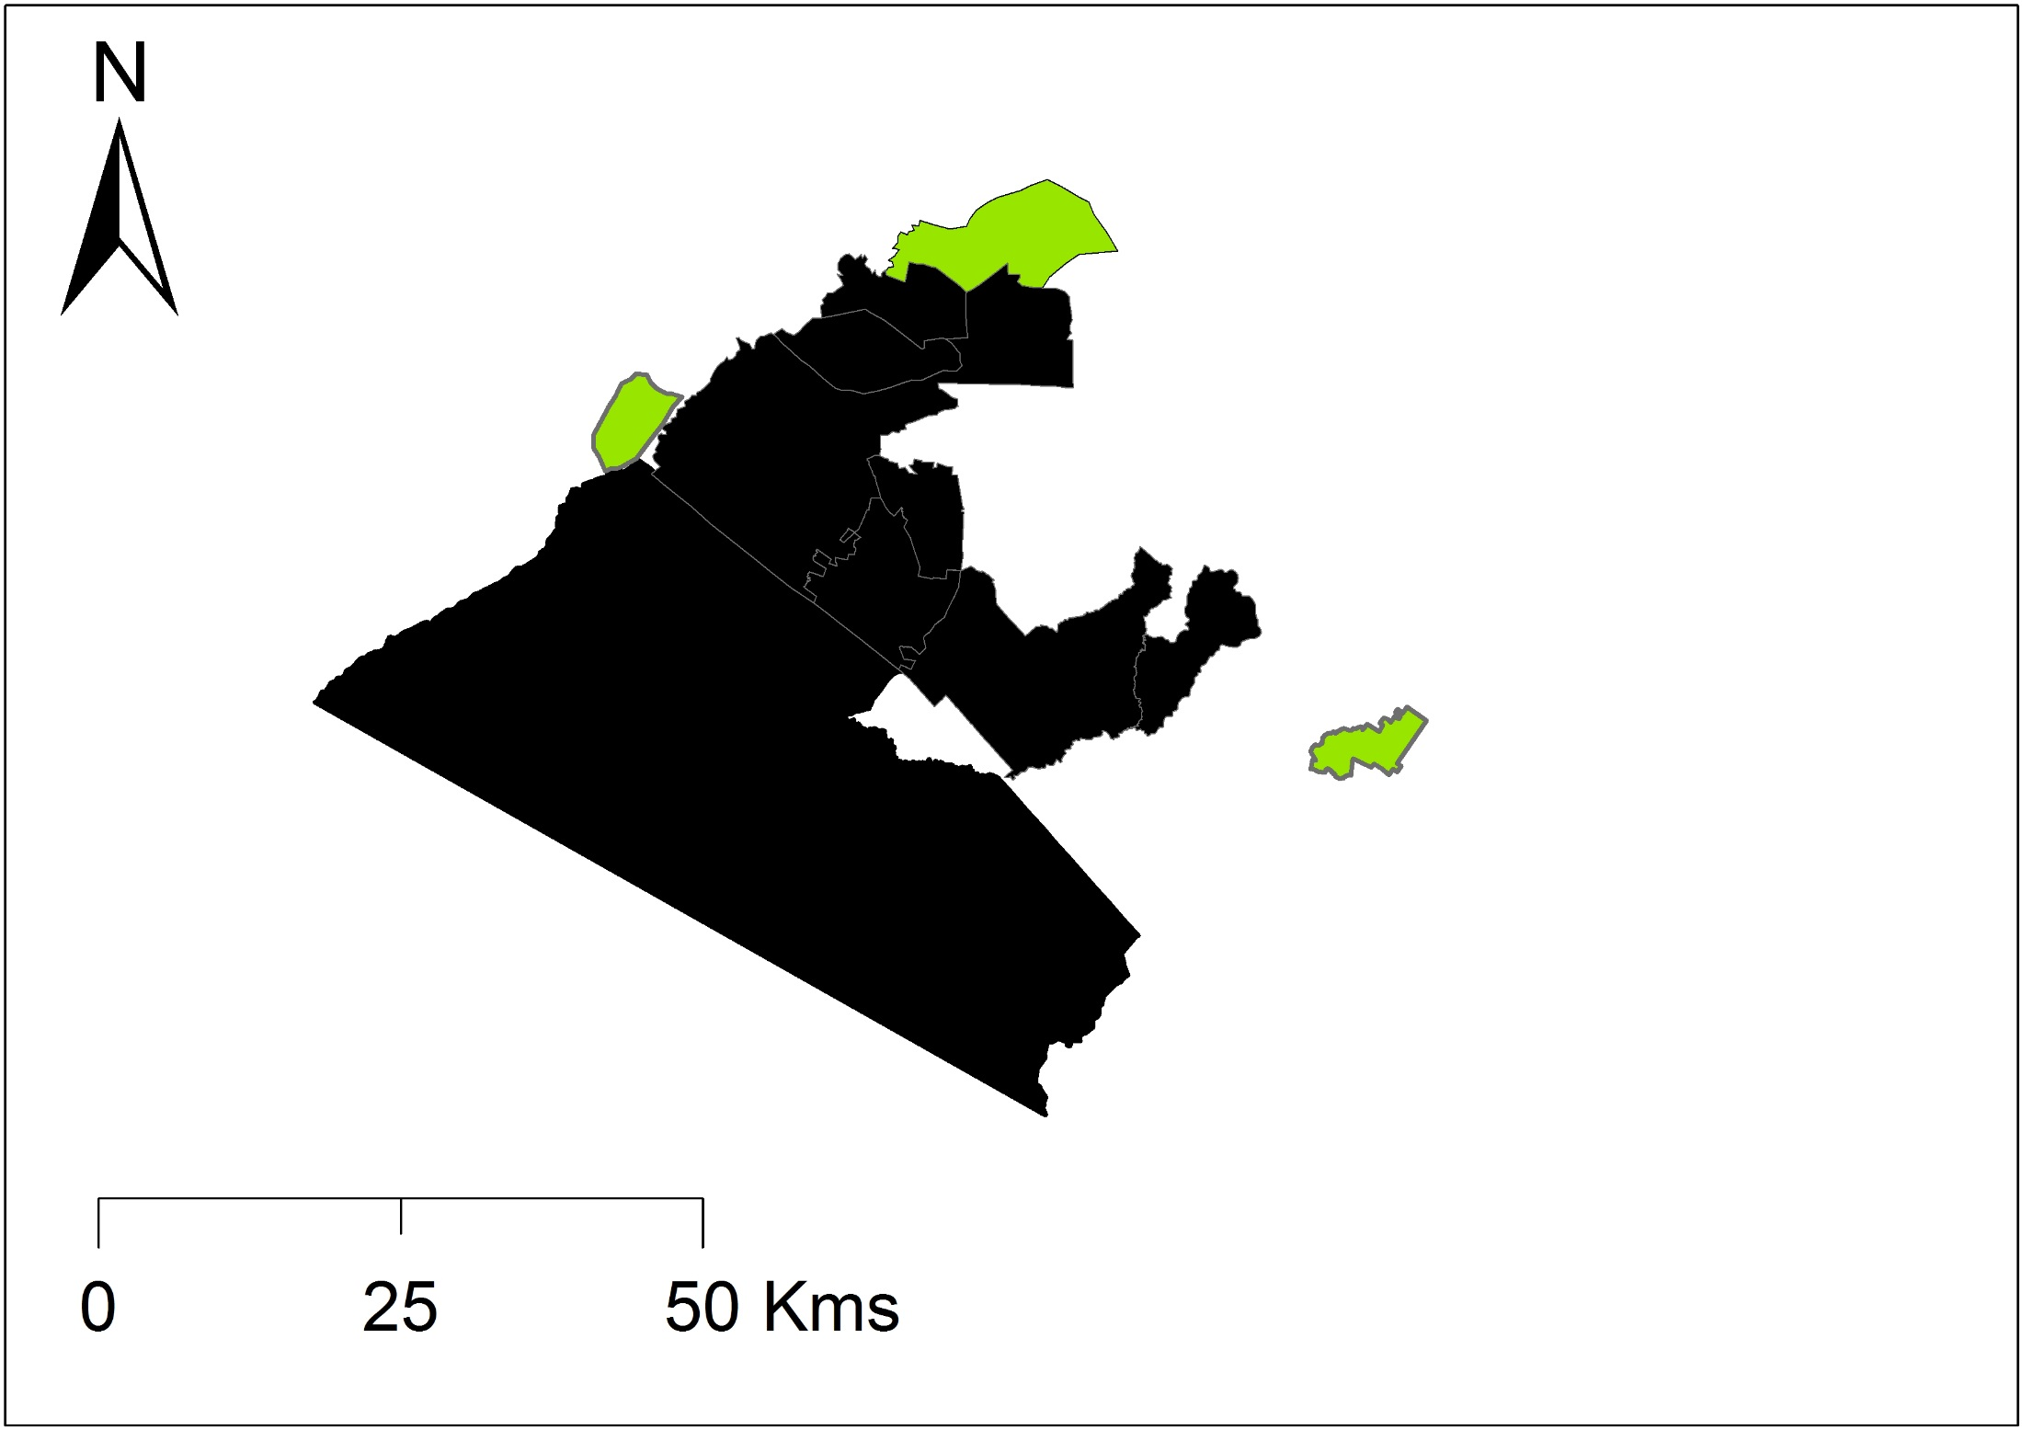
The evolution of the Maasai Mara ecosystem
•••
Study Area
2,398 km2
More later

Slide 21
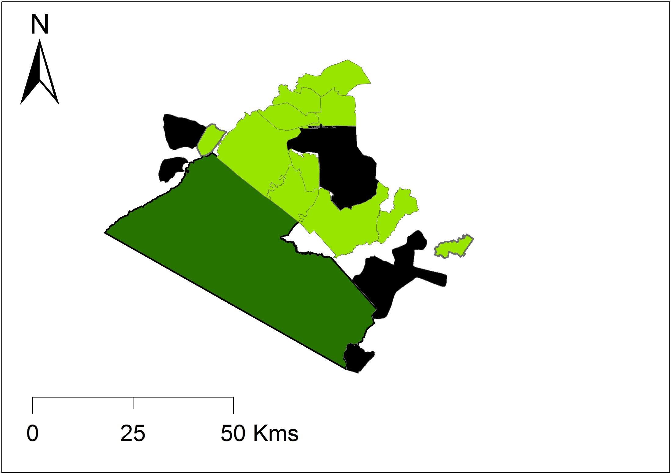
The evolution of the Maasai Mara ecosystem
•••
Proposed conservancies

Slide 22
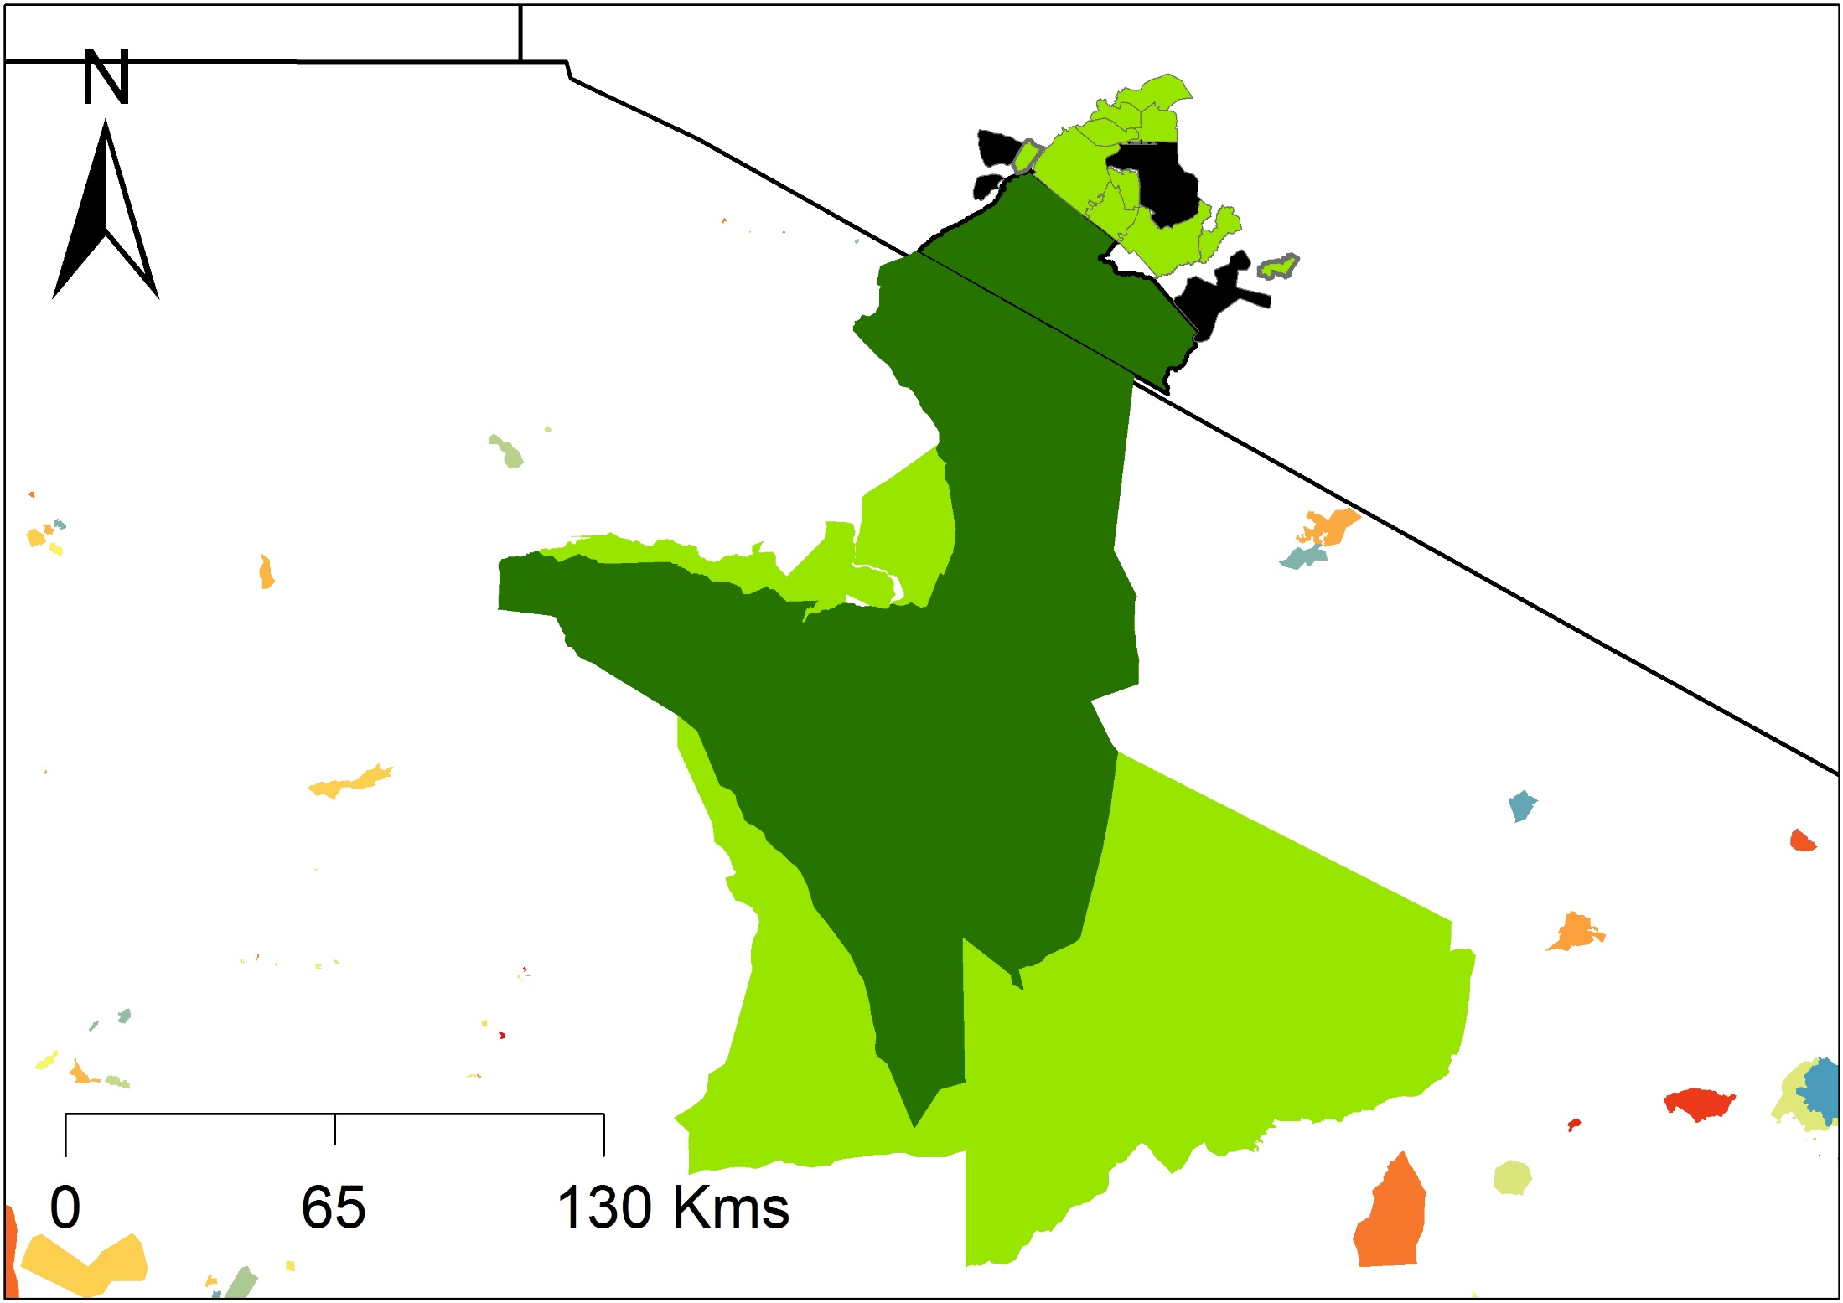
The evolution of the Maasai Mara ecosystem
•••
Broader context
Serengeti ecosystem

Slide 23
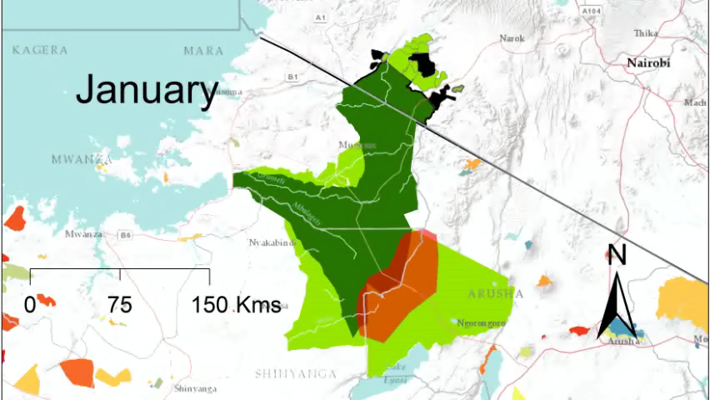
Wildebeest migration
•••

Slide 24
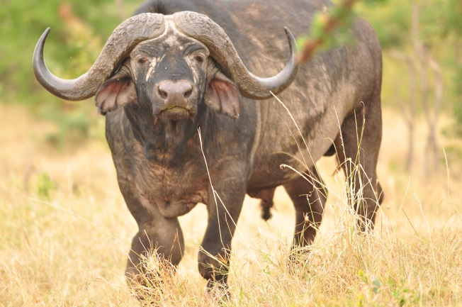
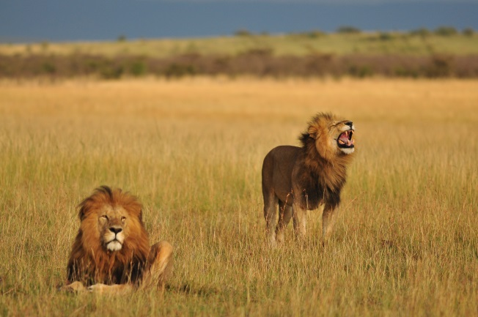
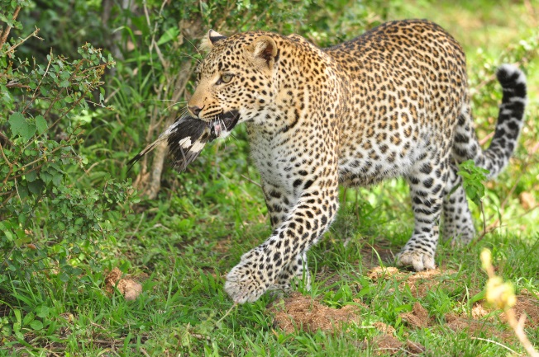
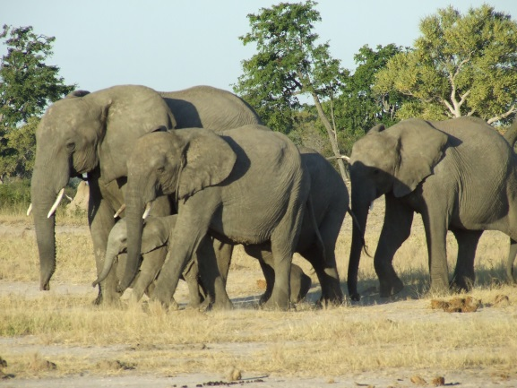
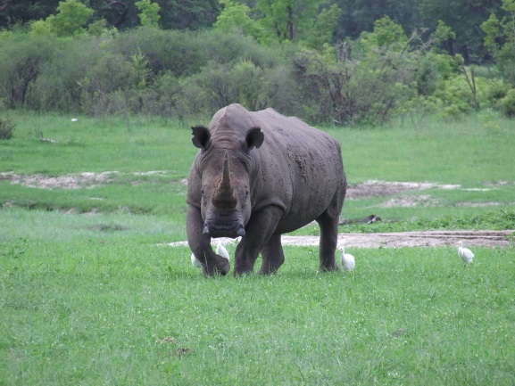
Status of the Mara lions
•••
The Mara – largely known for “The Big Five”

Slide 25
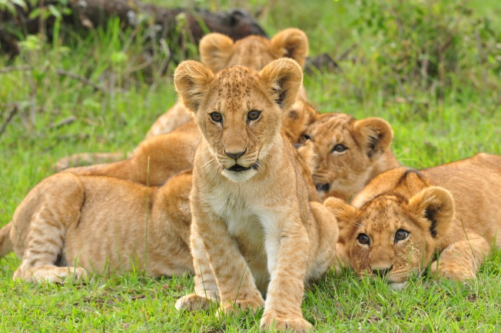
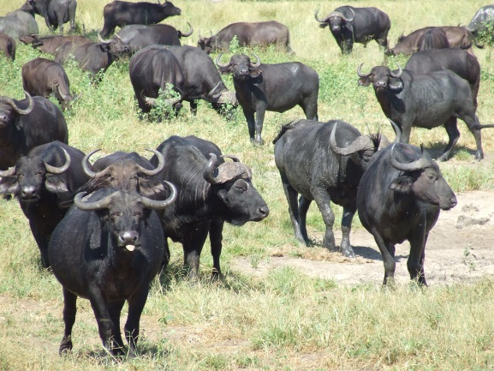
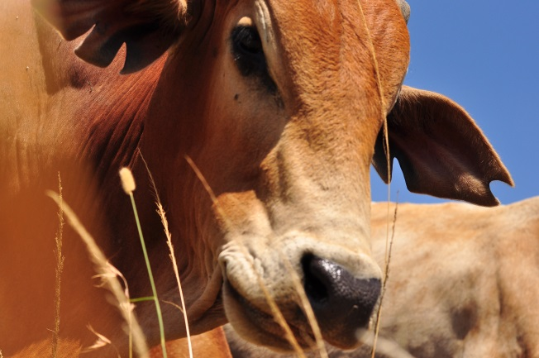
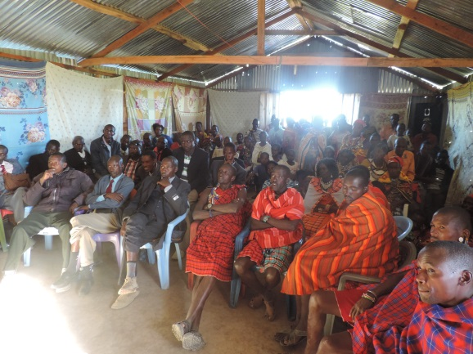
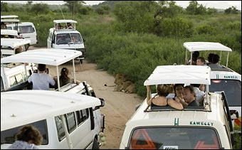
Status of the Mara lions
•••
The Mara – known increasingly for “The High Five”
Huge amounts of pressure

Slide 26
The Mara Lion and Cheetah Projects
•••
Widespread concern that lions & cheetahs are declining
Kenya Wildlife Trust initiated the Mara Lion and Cheetah Projects
Established mid 2013

Slide 27
Objective and focus areas
•••
Three core objectives of the projects
Establish lion/cheetah densities and trends over time
Identify threats to lions/cheetahs
Identify and implement solutions to these threats
But very little baseline data

Slide 28
Objective and focus areas
•••
Three core objectives of the projects
Establish lion/cheetah densities and trends over time
Identify threats to lions/cheetahs
Identify and implement solutions to these threats

Slide 29
Lion/cheetah densities
•••
Objectives
Establish a baseline of densities
Monitor trends over time
Outputs/papers
Y1 – Baseline density, sex ratios and home ranges
Y2 – Survival/mortality (per demographic)
- Incorporate other variables of influence (e.g. prey, livestock)
Y3 – Explore trends (per demographic)
Workplan
90 day sampling sessions
Two sessions / year – during migration (Aug-Oct) and outside the migration (Feb-Apr)

Slide 30

Status of the Mara lions
•••
Methods
Individual identification
Spatially explicit mark-recapture framework
Built a smart phone app (CyberTracker)

Slide 31
Lion/cheetah densities
•••
Why are we doing it like this?
Cannot count every lion/cheetah
Even if we could, it would take a year, during which time animals would have died, been born, emigrated, immigrated (Closed population – therefore 90 days)
Spatially explicit mark-recapture allows us to estimate densities during a snapshot
Most reliable form of counting – don’t trust any other numbers
Can then correlate certain variables e.g. cheetahs and hyaenas

Slide 32
Lion/cheetah densities
•••
How does SECR work?
A method used to determine population size/density
Why do we need to use it?
Because it is not practical to count all individuals
How does it work?
In it’s simplest form you
Capture and mark individuals
Released back into the wild
Sample again and recapture
Population size estimated based on number of marked individuals caught again

Slide 33
Mark Recapture - fundamentals
•••
How does this relate to what we are doing?
Capture and mark individuals
Take an individual ID photographs of all individuals seen on day 1
Released back into the wild
Drive off
Sample again and recapture
Go out again – take photos of all individuals seen
Population size estimated based on number of marked individuals caught again
How many have been recaptured?

Slide 34
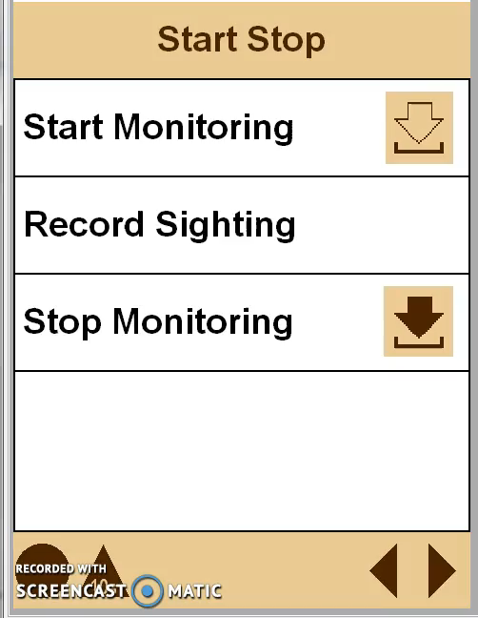
Lion/cheetah densities
•••
What we record?

Slide 35
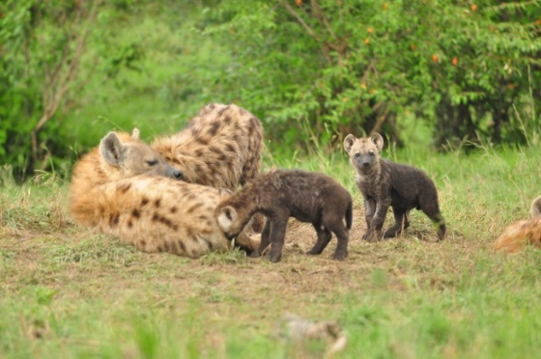
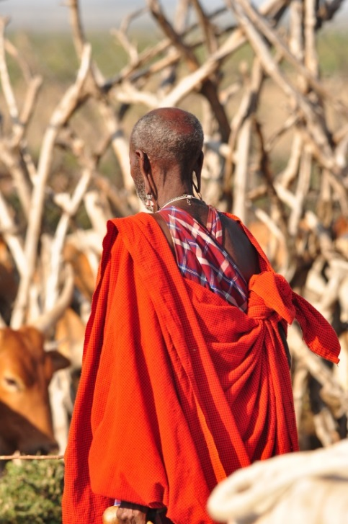
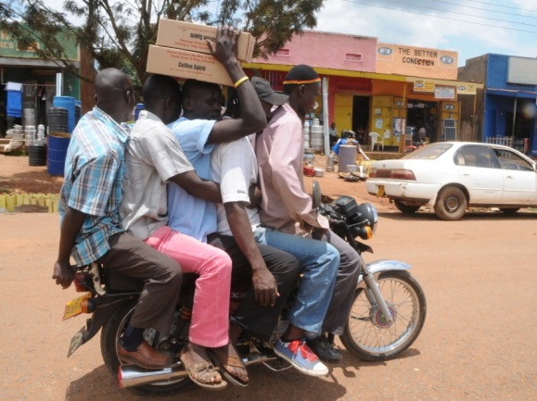
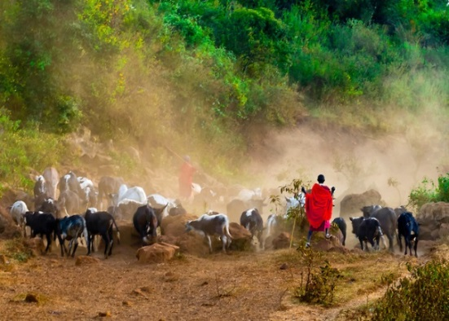
Lion/cheetah densities
•••
Densities
What we record
Effort (GPS point every ten seconds)
Lions and cheetahs – individual ID - SECR
All predators
All vehicles
All livestock
All people
Relative spatial abundance

Slide 36
Density results – in prep.
•••
Aug – Oct 2014
92 days of sampling
Effort = 8,397 km
Individual ID of all lions and cheetahs

Slide 37
Density results – in prep.
•••
Spatial representation of effort August – October 2014

Slide 38
Preliminary results - cheetahs
•••
Lion density 15.15 / 100km2 >1yr
Sex ratio = 2.2♀:1♂

Slide 39
Preliminary results - lions
•••
Mean pixel density 0.1 / 0.422km2
These 3 conservancies higher density than Reserve

Slide 40
Preliminary results - lions
•••
Mean pixel density Conservancies – 0.074
Reserve – 0.062

Slide 41
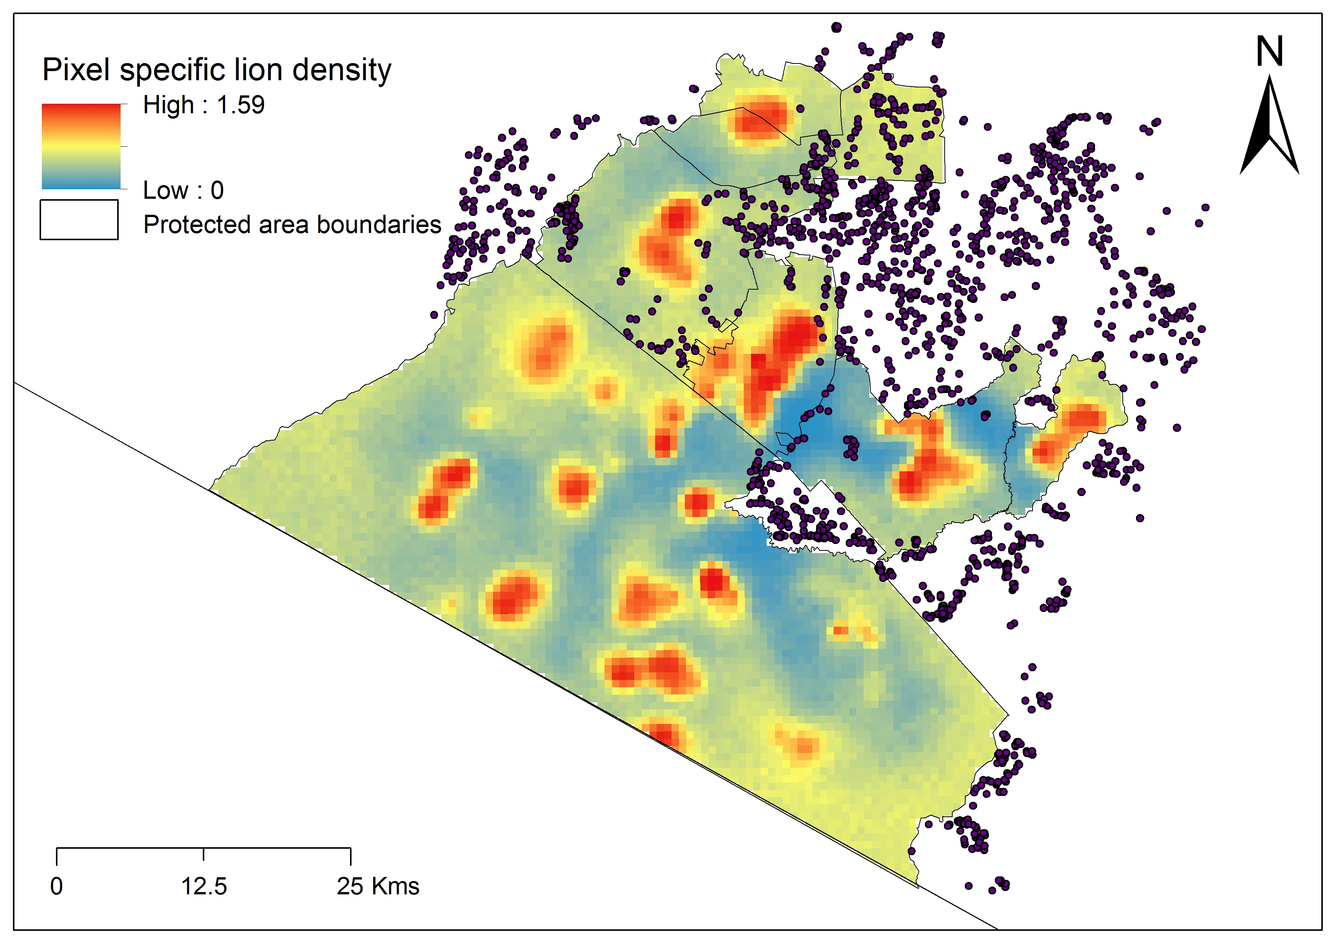
Next steps – pixel specific densities related to other variables
•••

Slide 42
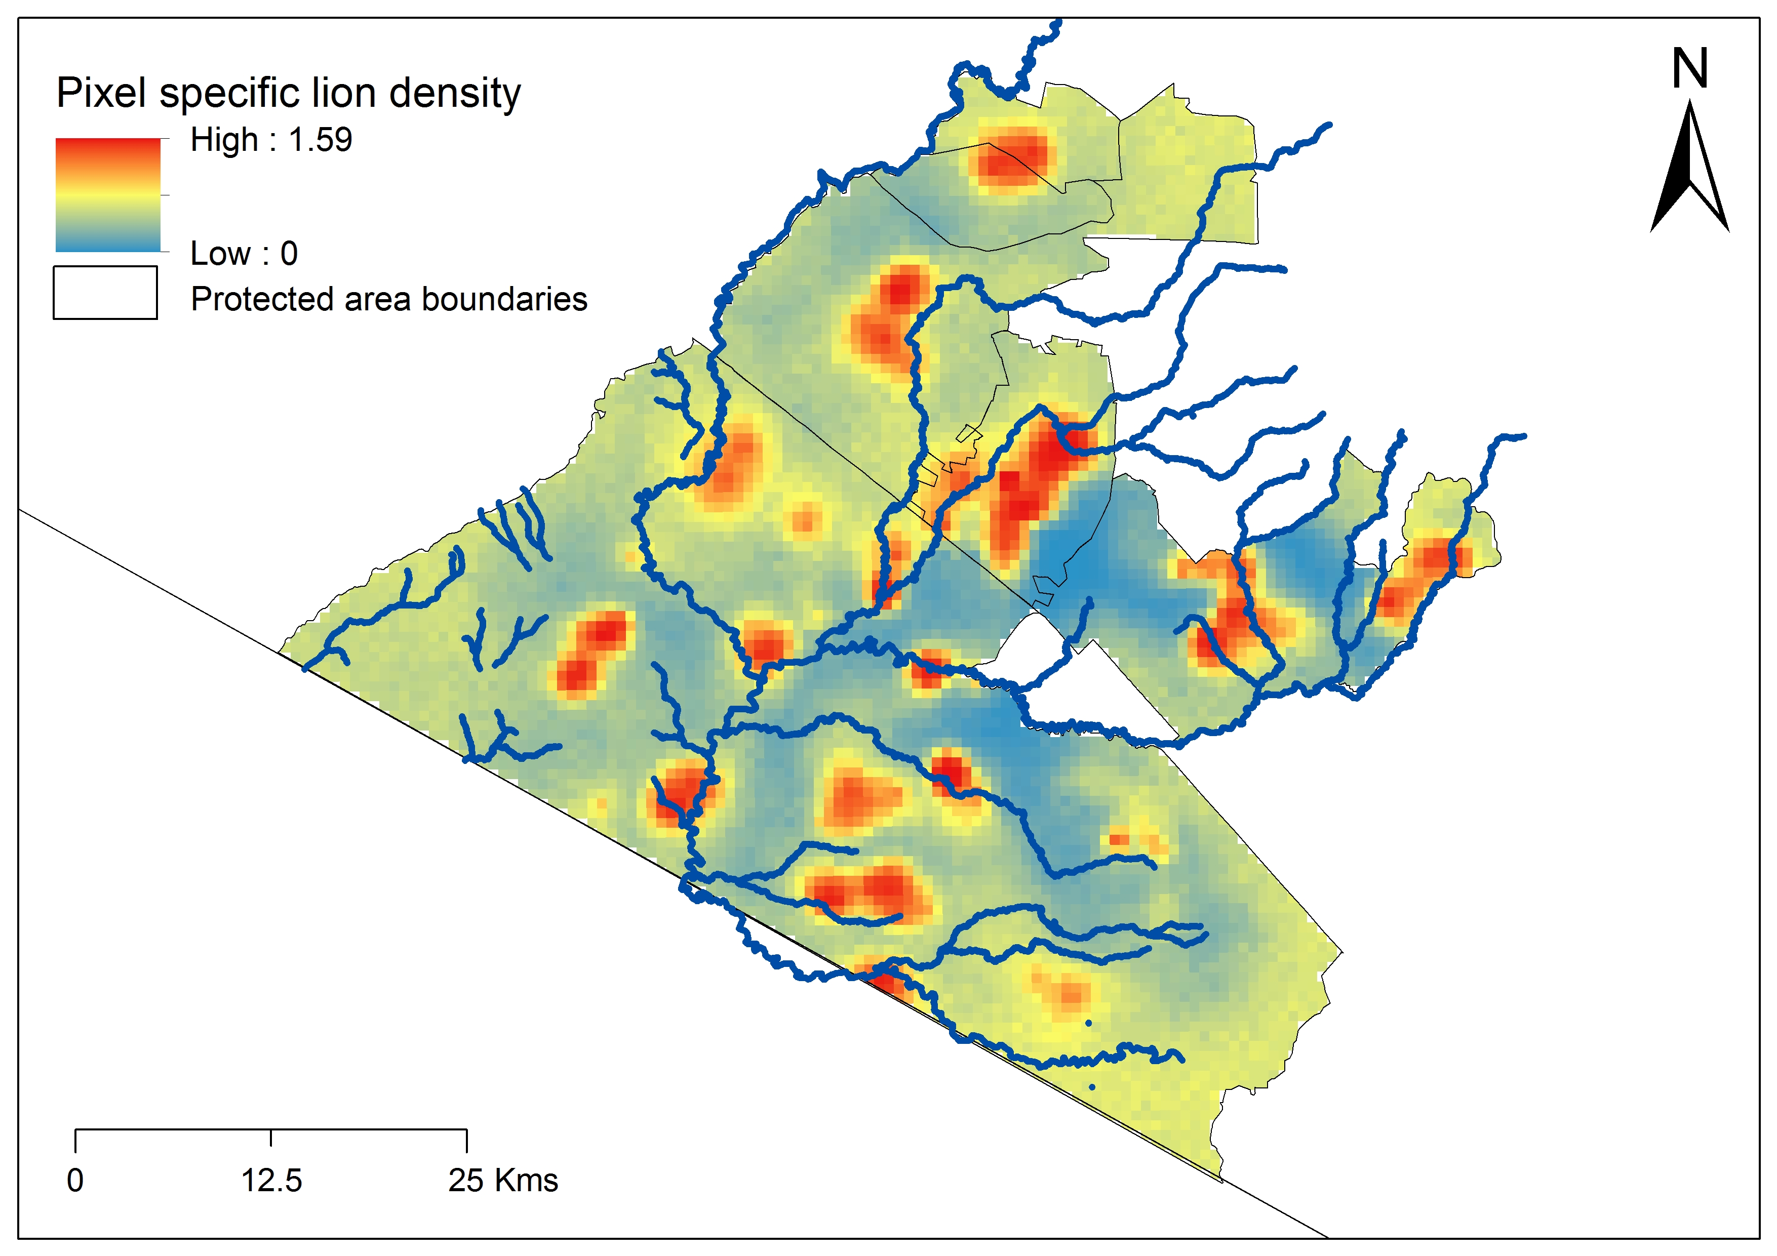
Next steps – pixel specific densities related to other variables
•••

Slide 43
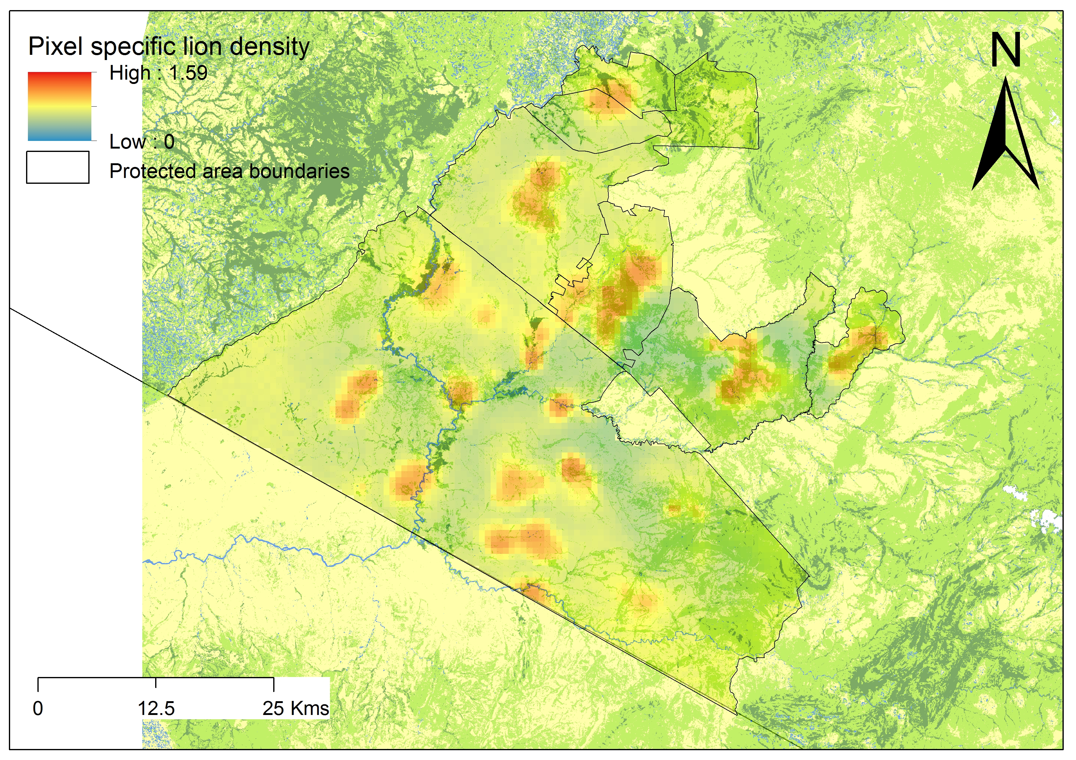
Next steps – pixel specific densities related to other variables
•••

Slide 44
Next steps – pixel specific densities related to other variables
•••
Livestock abundance

Slide 45
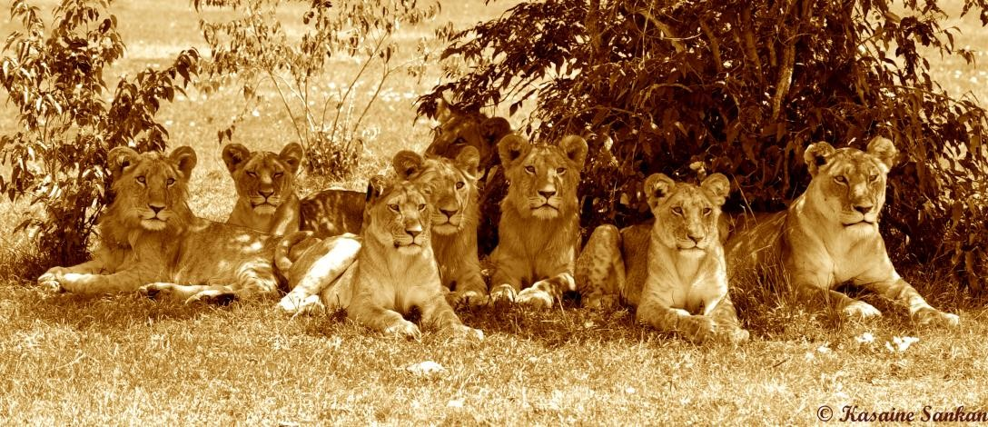
Next steps – pixel specific densities related to other variables
•••
Going forwards
Survival per demographic
Accurate monitoring of the population per demographic

Slide 46
Objective and focus areas
•••
Three core objectives of the projects
Establish lion/cheetah densities and trends over time
Identify threats to lions/cheetahs
Identify and implement solutions to these threats

Slide 47
Objective and focus areas
•••
Three core objectives of the projects
Establish lion/cheetah densities and trends over time
Identify threats to lions/cheetahs
Identify and implement solutions to these threats

Slide 48
Threats
•••
Objectives
Establish what threats may be impacting lion/cheetah populations (not individuals)
Outputs
According to threat
Workplan
Disease
Genetics
Connectivity
Livestock grazing practices
HWC
Depleting prey
Habitat loss
Interventions
Stress

Slide 49
Threats - Disease
•••
Objectives
Identify health status of lions/cheetahs
Identify diseases present in lions/cheetahs
Identify diseases of potential concern to lions/cheetahs
Quantify impacts of disease on the population
Establish protocols to deal with potential epidemics
Establish transmission routes of diseases
Outputs/papers
Case studies of outbreaks (e.g. mange or sick lion cubs in MNC)
Overall study of health status of lions/cheetahs
Diseases of concern
Transmission of disease
Management implications
Management policy for limiting spread of disease
Workplan
Blood samples during ALL lion/cheetah immobilisations
Necropsies of all dead lions/cheetahs
KWS/SI/KWT collaboration with BAND funding
All samples go to KWS labs, and if possible, exported where necessary

Slide 50
Threats - Genetics
•••
Objectives
Assess genetic integrity of lions/cheetahs
Outputs/papers
Effective population size
Genetic diversity
Lineage
Landscape genetics (connectivity)
Dispersal distances
Susceptibility to diseases
Dispersal patterns (who goes where and with whom?)
Management implications
Report on connectivity and genetic integrity (describing social ecology)
Workplan
Biopsy samples (June/July)
Blood samples during ALL lion/cheetah immobilisations
Necropsies of all dead lions/cheetahs
Collection of fecal samples

Slide 51
Threats – Stress
•••
Objectives
Explore whether cheetahs (maybe lions) are experiencing stress
Explore the implications of such stress
Outputs/papers
Stress levels according to tourism, livestock and different areas
Are stressed animals more likely to suffer from disease?
Is there a reproductive link?
Are there survival (longevity) implications?
Management implications
Best practices for tourism behavior
Best practices for livestock management
Changes to certain areas that are important to movement (e.g. settlements)
Workplan
Collection of fecal samples (collars)
Collection of observational data to link to stress (collars)
Collection of location data to link to stress (collars)

Slide 52
Threats - Connectivity
•••
Objectives
Assess levels of connectivity from the Mara to other sub-populations
Outputs/papers
Current levels of connectivity
Identification of potential corridors
Exploration of genetic impacts on connectivity
Simulate scenarios of landuse change to explore impacts of e.g. fencing
Management implications
Which area of land is most important to protect for e.g. corridors
Identify ways of improving connectivity (e.g. fences)
Workplan

Slide 53
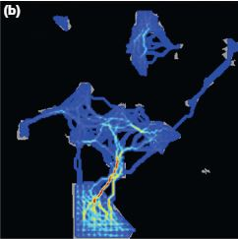
Threats - Connectivity
•••

Slide 54
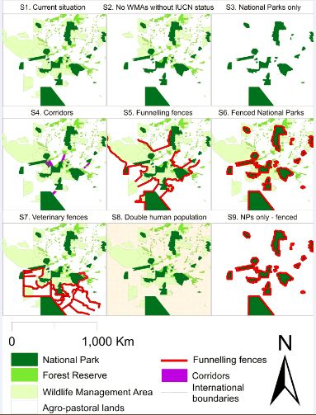
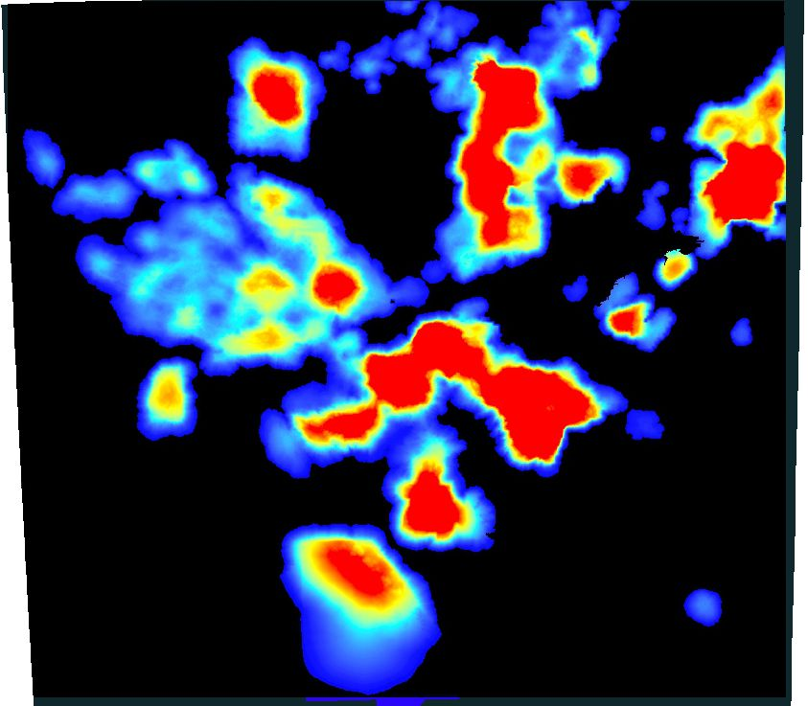
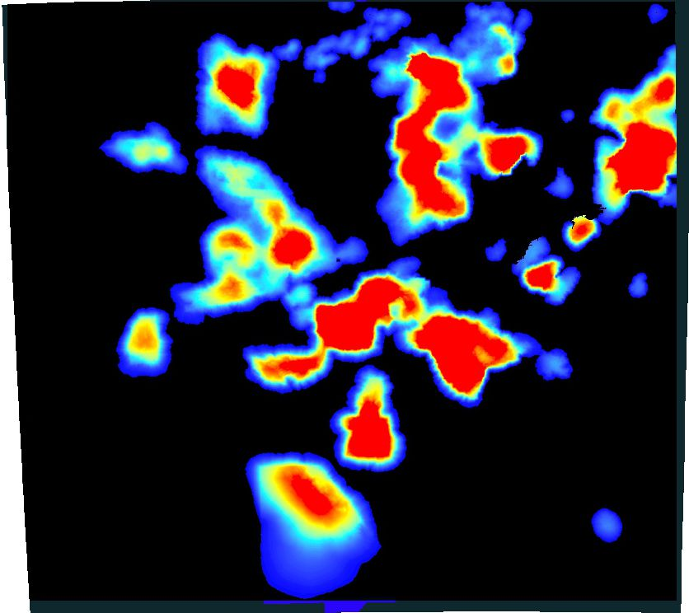
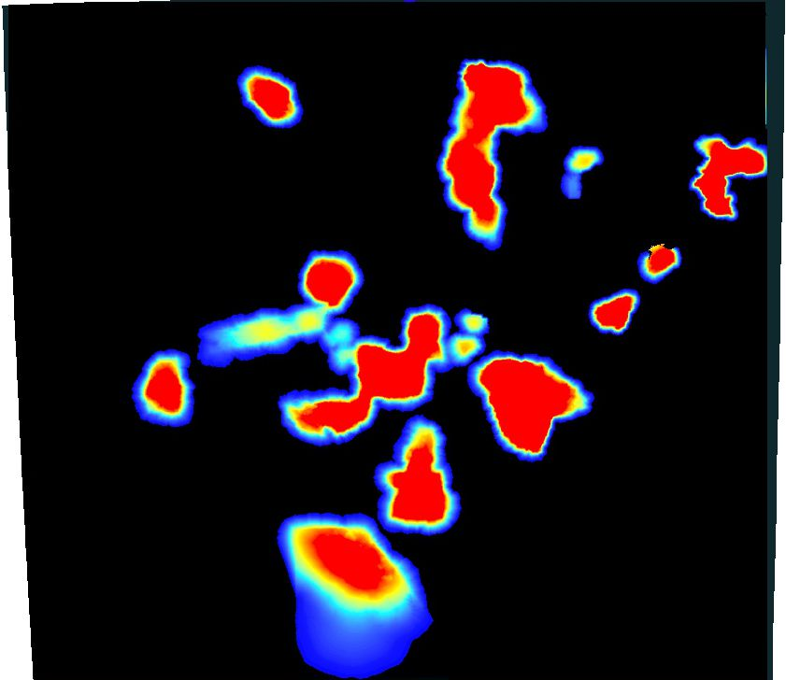
Threats - Connectivity
•••

Slide 55
Threats - Connectivity
•••
Objectives
Assess levels of connectivity from the Mara to other sub-populations
Outputs/papers
Current levels of connectivity
Identification of potential corridors
Exploration of genetic impacts on connectivity
Simulate scenarios of landuse change to explore impacts of e.g. fencing
Management implications
Which area of land is most important to protect for e.g. corridors
Identify ways of improving connectivity (e.g. fences)
Implications of HWC with increased connectivity
Workplan
Deployment of collars on sub-adult male lions
Deployment of collars on female cheetahs
Aquiring of spatial layers (e.g. fencing, habitat map, settlement map) to test scenarios

Slide 56
Threats – Human-wildlife conflict
•••
Objectives
Assess the impacts of HWC on the lion/cheetah population
Outputs/papers
What are people’s perceptions towards lions/cheetahs?
What are the problems that people face and that lions face
- Under what circumstances
What are the solutions that the community want?
Are they effective?
Management implications
What is the level of HWC conflict
At current levels, what is the impact on the lion/cheetah population?
What demographic is most affected?
Where are the main problem areas (hotspots)
What situation is causing the most problems (e.g. MMNR, conservancies, community)
What solutions are applicable to the Mara?
Workplan
Film
Questionnaire survey (to be repeated)
Conflict reports
Genetic analysis of diet to determine prevalence of livestock

Slide 57
Threats – Prey
•••
Objectives
Monitor trends in prey populations and assess impacts of fluctuations on lion/cheetah populations
Outputs/papers
Trends over time in prey populations
- Migration vs non migration
Spatial aggregation of prey and lions/cheetahs
Implications for lion/cheetah ecology and populations
Management implications
Fluctuations in prey will have major impacts on lions/cheetahs
Recommendations for livestock grazing and its impacts on natural prey
Is the migration declining
Focus on e.g. Loita migration?
Workplan
Prey surveys conjointly with lion/cheetah monitoring?
DRSRS?

Slide 58
Threats – Fire/Livestock grazing practices
•••
Objectives
Explore impacts of current and potential management practices on lion/cheetah populations
Outputs/papers
Towards an integrated ecosystem of livestock and wildlife
Impacts of livestock on lion/cheetah behavior (tourism angle)
Impacts of controlled burning on lions/cheetahs
Management implications
Report on best practices of management
Disease spread
Impacts on prey
Impacts on lions/cheetahs
Workplan
Discuss and plan

Slide 59
Threats – Habitat loss
•••
Objectives
Explore whether potential habitat loss (areas outside conservancies and habitats within PAs) is impacting the lion/cheetah population
Outputs/papers
The impacts of habitat loss on wild prey and free ranging lions/cheetahs
The impacts of a changing habitat on lions/cheetahs
Management implications
The importance of maintaining current conservancies
The importance of protecting lands outside of current conservancies
In terms of resident animals
In terms of movement routes
The importance of maintaining habitats
Workplan
Habitat map
Fencing maps
Discuss and plan

Slide 60
Threats – Interventions
•••
Objectives
Explore the impacts of interventions (treatment, supplemental feeding and tourist intervention) on lions/cheetahs
Outputs/papers
Do do-gooders do good?
Management implications
Increased survival of adult females
Increased tenure of adult males
Increased cub survival
increased sub-adults = increased dispersers with nowhere to go
= increased conflict?
Workplan
Mainly through simulation models
Records of interventions (treatments, but no records of feeding or tourist interventions)

Slide 61
Threats
•••
Objectives
Establish what threats may be impacting lion/cheetah populations (not individuals)
Outputs
According to threat
Workplan
Disease
Genetics
Connectivity
Livestock grazing practices
HWC
Depleting prey
Habitat loss
Interventions
Stress

Slide 62
How it all links together?
•••
Population monitoring
Disease
Interventions
Genetics
Connectivity
Stress
Prey
HWC

Slide 63
How it all links together?
•••
Consistent monitoring is critical to determining threats
Disease
Interventions
Y1
Genetics
Population monitoring
Y2
Connectivity
Y3
Y4
Stress
Prey
HWC

Slide 64
How it all links together?
•••
What is having the biggest impact on current population?
Disease
Interventions
Y1
Genetics
Population monitoring
Y2
Connectivity
Y3
Y4
Stress
Prey
HWC

Slide 65
How it all links together?
•••
Population monitoring
Disease
Interventions
Genetics
Connectivity
Stress
Prey
HWC

Slide 66
How it all links together?
•••
Population monitoring
Disease
Interventions
Genetics
IBM
Connectivity
Stress
Prey
HWC

Slide 67
How it all links together?
•••
Simulation model to explore current and future impacts of potential threats on lion populations
Incorporate
Population density
Sex ratio
Demographic ratios
Survival per demographic
Movement
Add threats
Over time what are the impacts?
If we were to change x what are the impacts?

Slide 68
How it all links together?
•••
Population monitoring
Disease
Current density
Sex ratios
Current mortality per demographic
Interventions
Y5
Genetics
IBM
Y10
Connectivity
Y15
Y20
Stress
Prey
HWC

Slide 69
How it all links together?
•••
Population monitoring
Disease
Interventions
Current disease mortality
Potential outbreaks
Y5
Genetics
IBM
Y10
Connectivity
Y15
Y20
Stress
Prey
HWC

Slide 70
How it all links together?
•••
Population monitoring
Disease
Interventions
Y5
Genetics
Current genetic make-up
Changes due to
IBM
Y10
Connectivity
Y15
Y20
Stress
Prey
HWC

Slide 71
How it all links together?
•••
Population monitoring
Disease
Interventions
Y5
Genetics
IBM
Y10
Connectivity
Impacts of stress
Increase stress
Y15
Y20
Stress
Prey
HWC

Slide 72
How it all links together?
•••
Population monitoring
Disease
Interventions
Y5
Genetics
IBM
Y10
Connectivity
Y15
Y20
Stress
HWC conflict increase
HWC decrease
Changes per demographic
Prey
HWC

Slide 73
How it all links together?
•••
Population monitoring
Disease
Interventions
Y5
Genetics
IBM
Y10
Connectivity
Y15
Y20
Stress
Prey
HWC
Prey decrease
Prey increase
Stable prey

Slide 74
How it all links together?
•••
Population monitoring
Disease
Interventions
Y5
Genetics
IBM
Y10
Connectivity
Y15
Connectivity loss
Connectivity gain
Y20
Stress
Prey
HWC

Slide 75
How it all links together?
•••
Population monitoring
Current interventions
Increased interventions
No intervention
Disease
Interventions
Y5
Genetics
IBM
Y10
Connectivity
Y15
Y20
Stress
Prey
HWC

Slide 76
How it all links together?
•••
Population monitoring
Many are linked together
Disease
Interventions
Genetics
IBM
Connectivity
Stress
Prey
HWC

Slide 77
How it all links together?
•••
Population monitoring
Hence they all feed in together
Disease
Interventions
Y5
Genetics
IBM
Y10
Connectivity
Y15
Y20
Stress
Prey
HWC
Management practices?

Slide 78
IBM specifics
•••
The above is all long-term, best case scenario, but something to aim for and keep in mind as we go forwards so that the model can be fflexible to accommodate new things
Objective
To develop a predictive, flexible model that can simulate a variety of realistic scenarios in order to explore their impact on the Mara lion population

Slide 79
IBM specifics
•••
In the short term we should aim for a model that in it’s most basic form will have the following functionality:
Density of lions as per our surveys
Sex ratio of lions as per our surveys
Rules relating to social structure
Rules relating to births and deaths
Rules relating to movement (according to age and status)
A spatial element so as to incorporate e.g. conflict, landuse change
Rules relating to movement around key features, e.g. settlements, rivers etc
The ability to run simulations of e.g. 20 years to assess changes to the population, changes to levels of conflict etc.
Functionality to build in prey, disease, genetic flow

Slide 80
IBM specifics
•••

